Slide 1
E500 SOURCE HEAD
Maintenance Assembly
Reference
IMPLANTER-Diffusion Department
Prepare by: SAMUEL 山姆爾 SaSPAREDOC.03

Slide 2
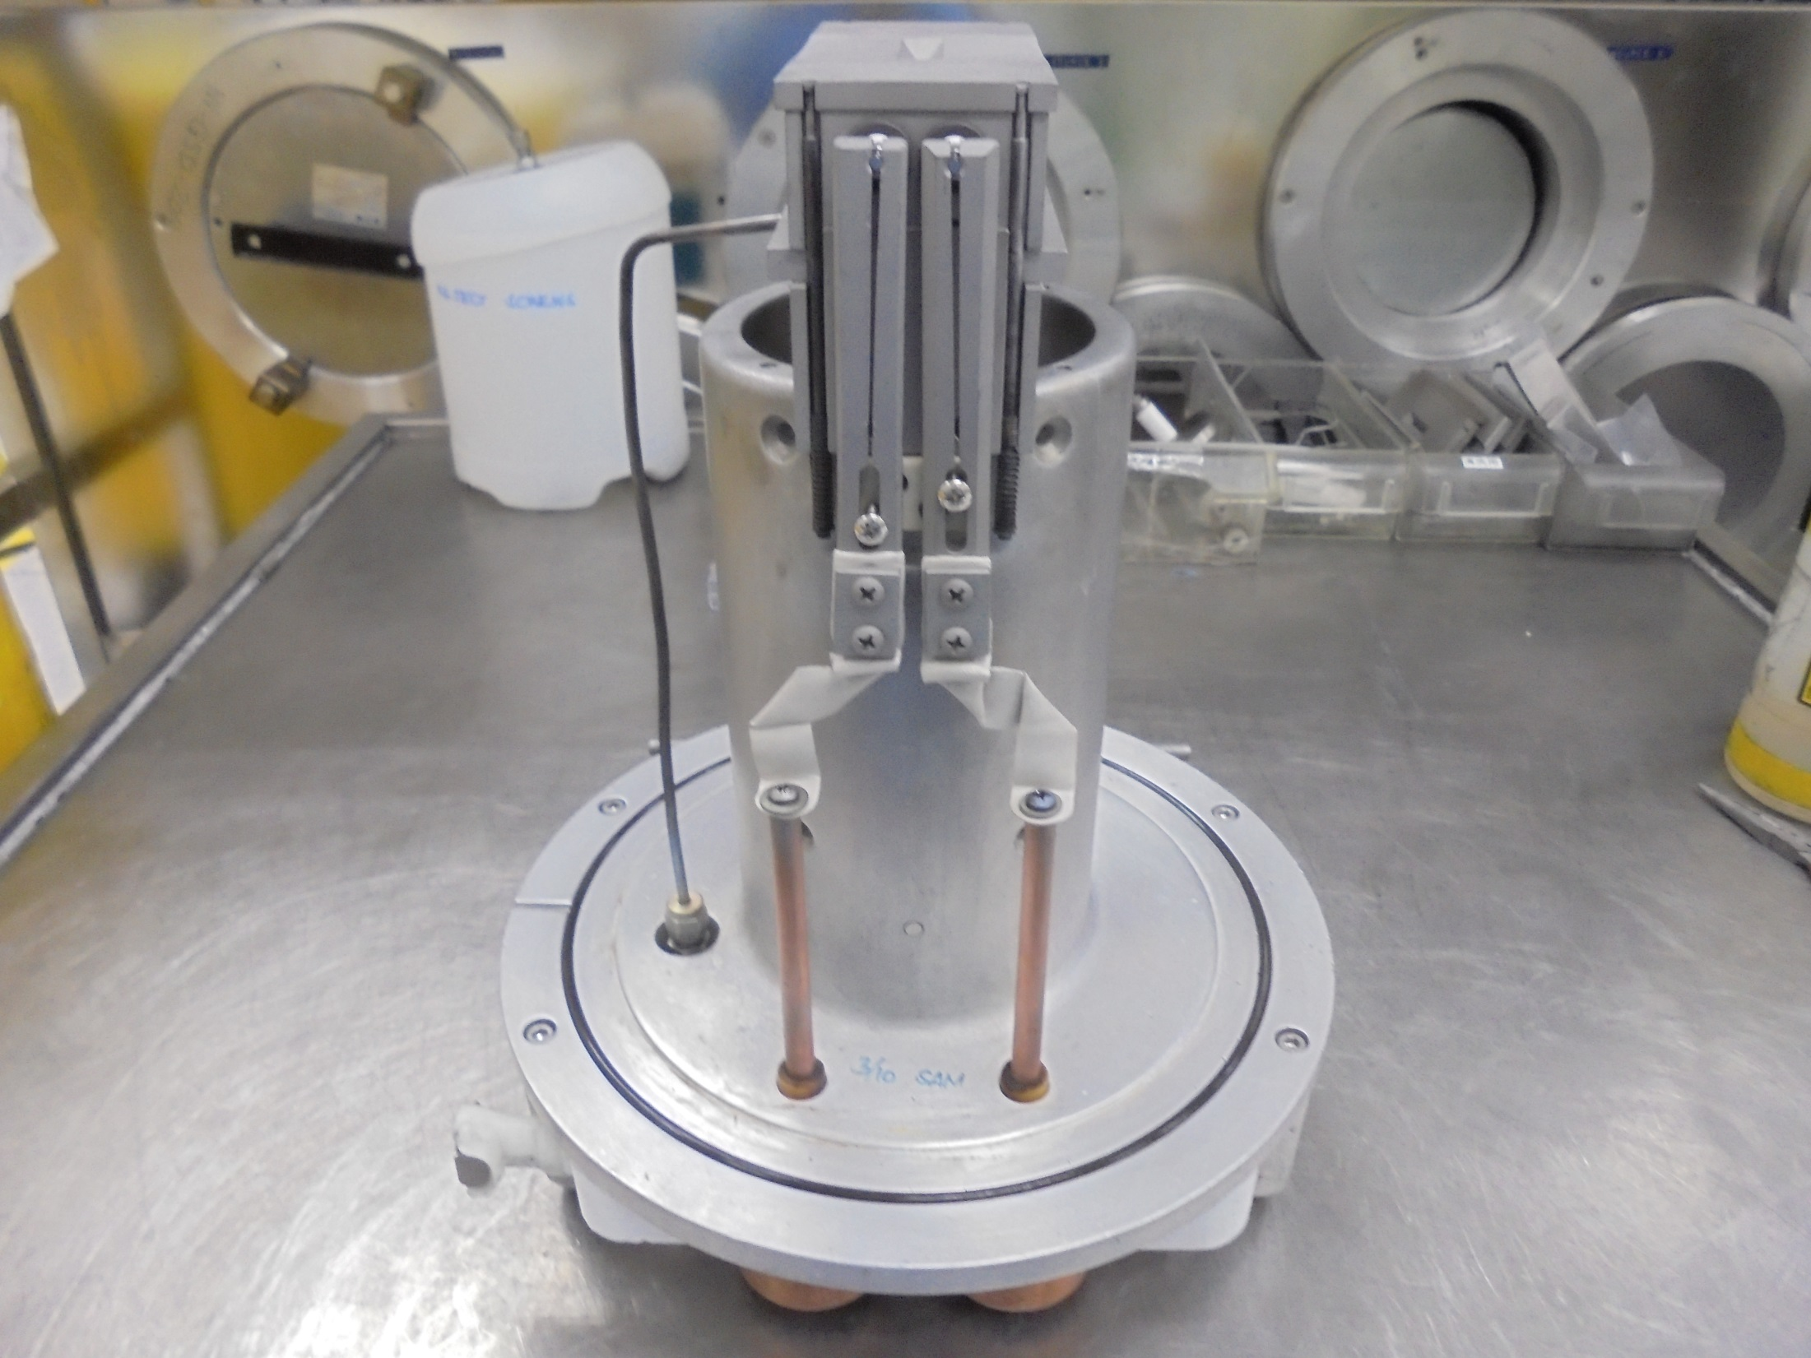
E500 SOURCE HEAD

Slide 3
Consumable Parts

Slide 4
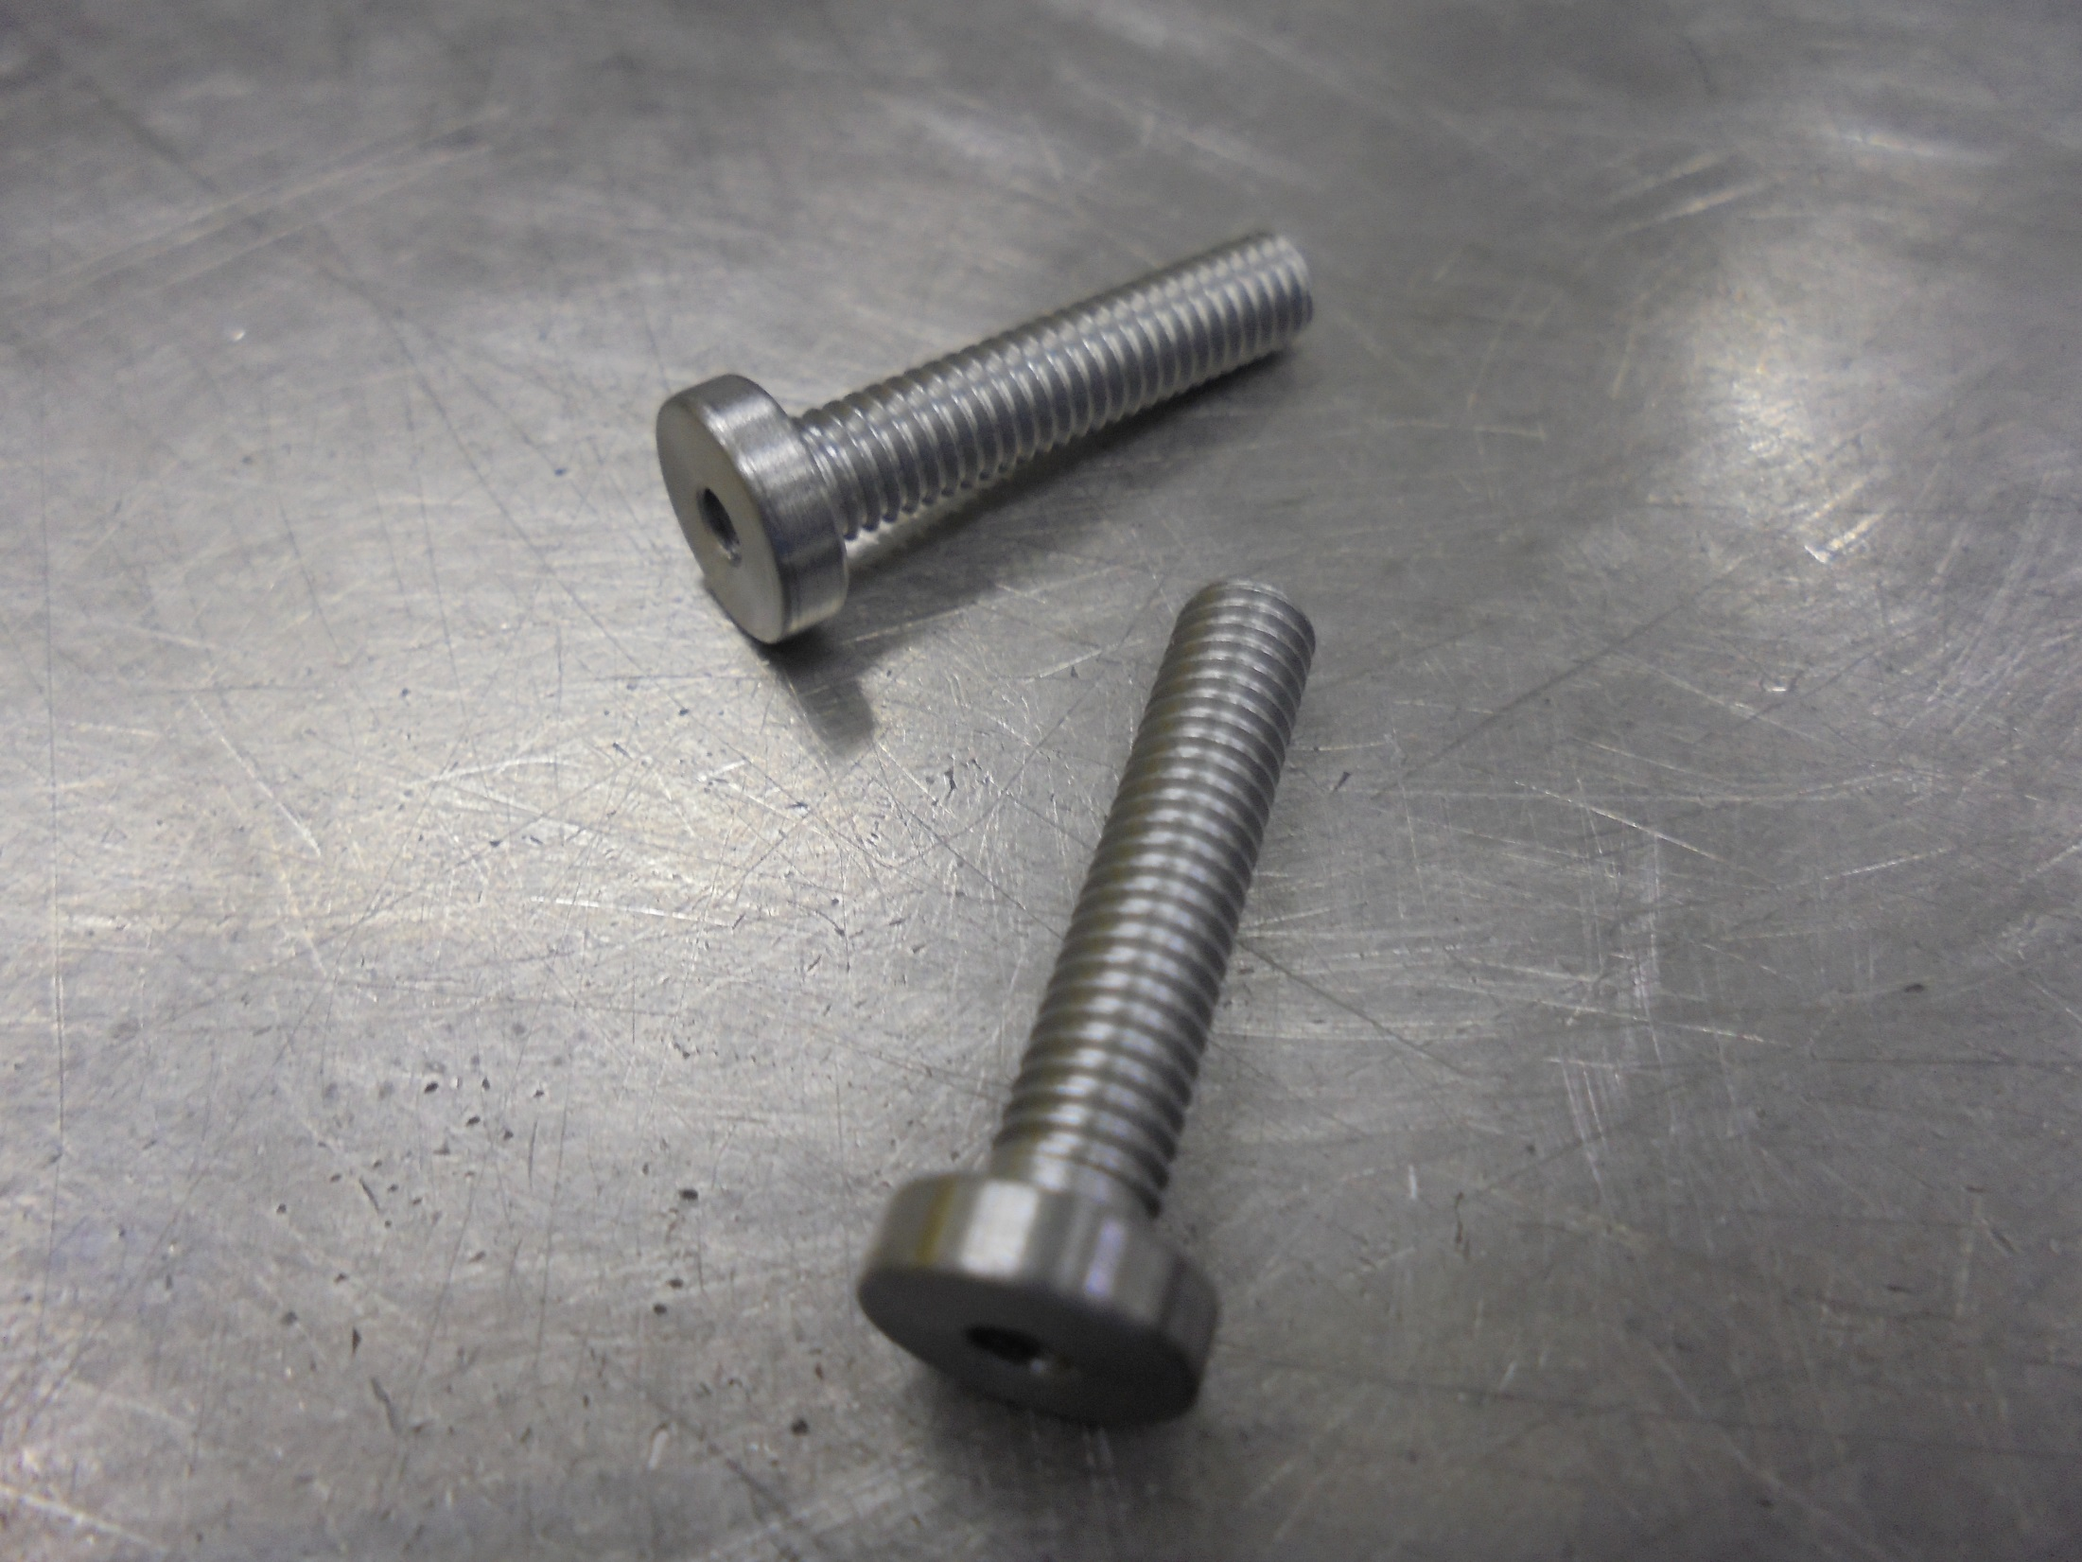
FILAMENT SCREW

Slide 5
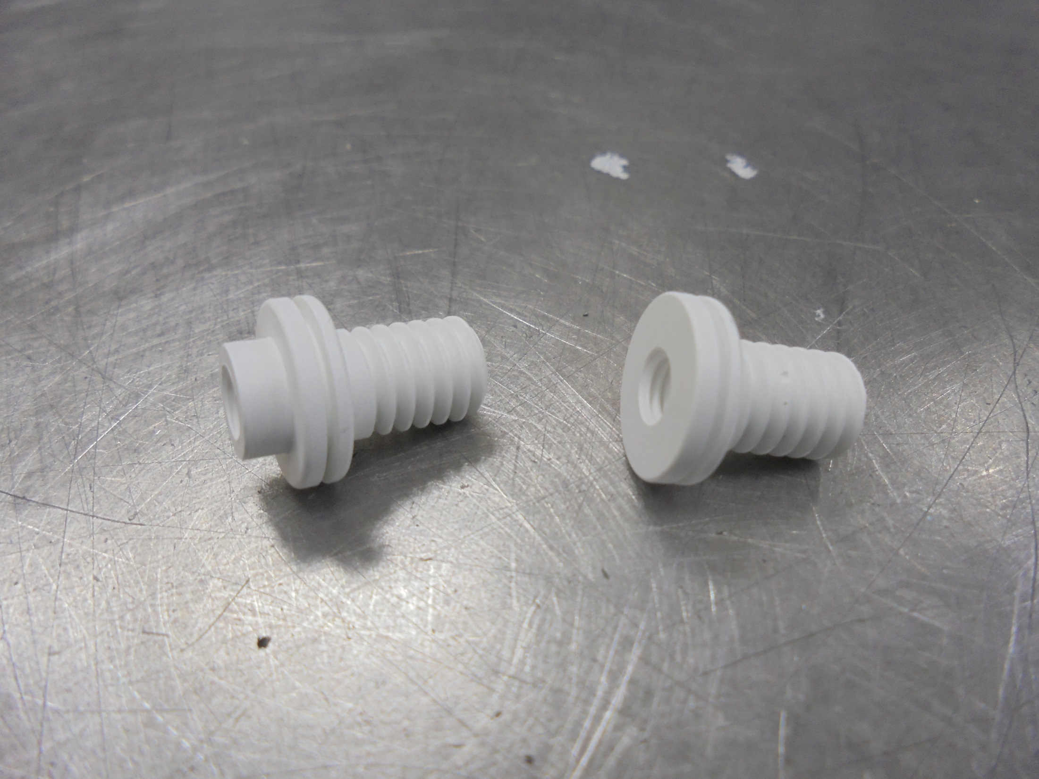
FILAMENT INSULATOR
Long
Short

Slide 6
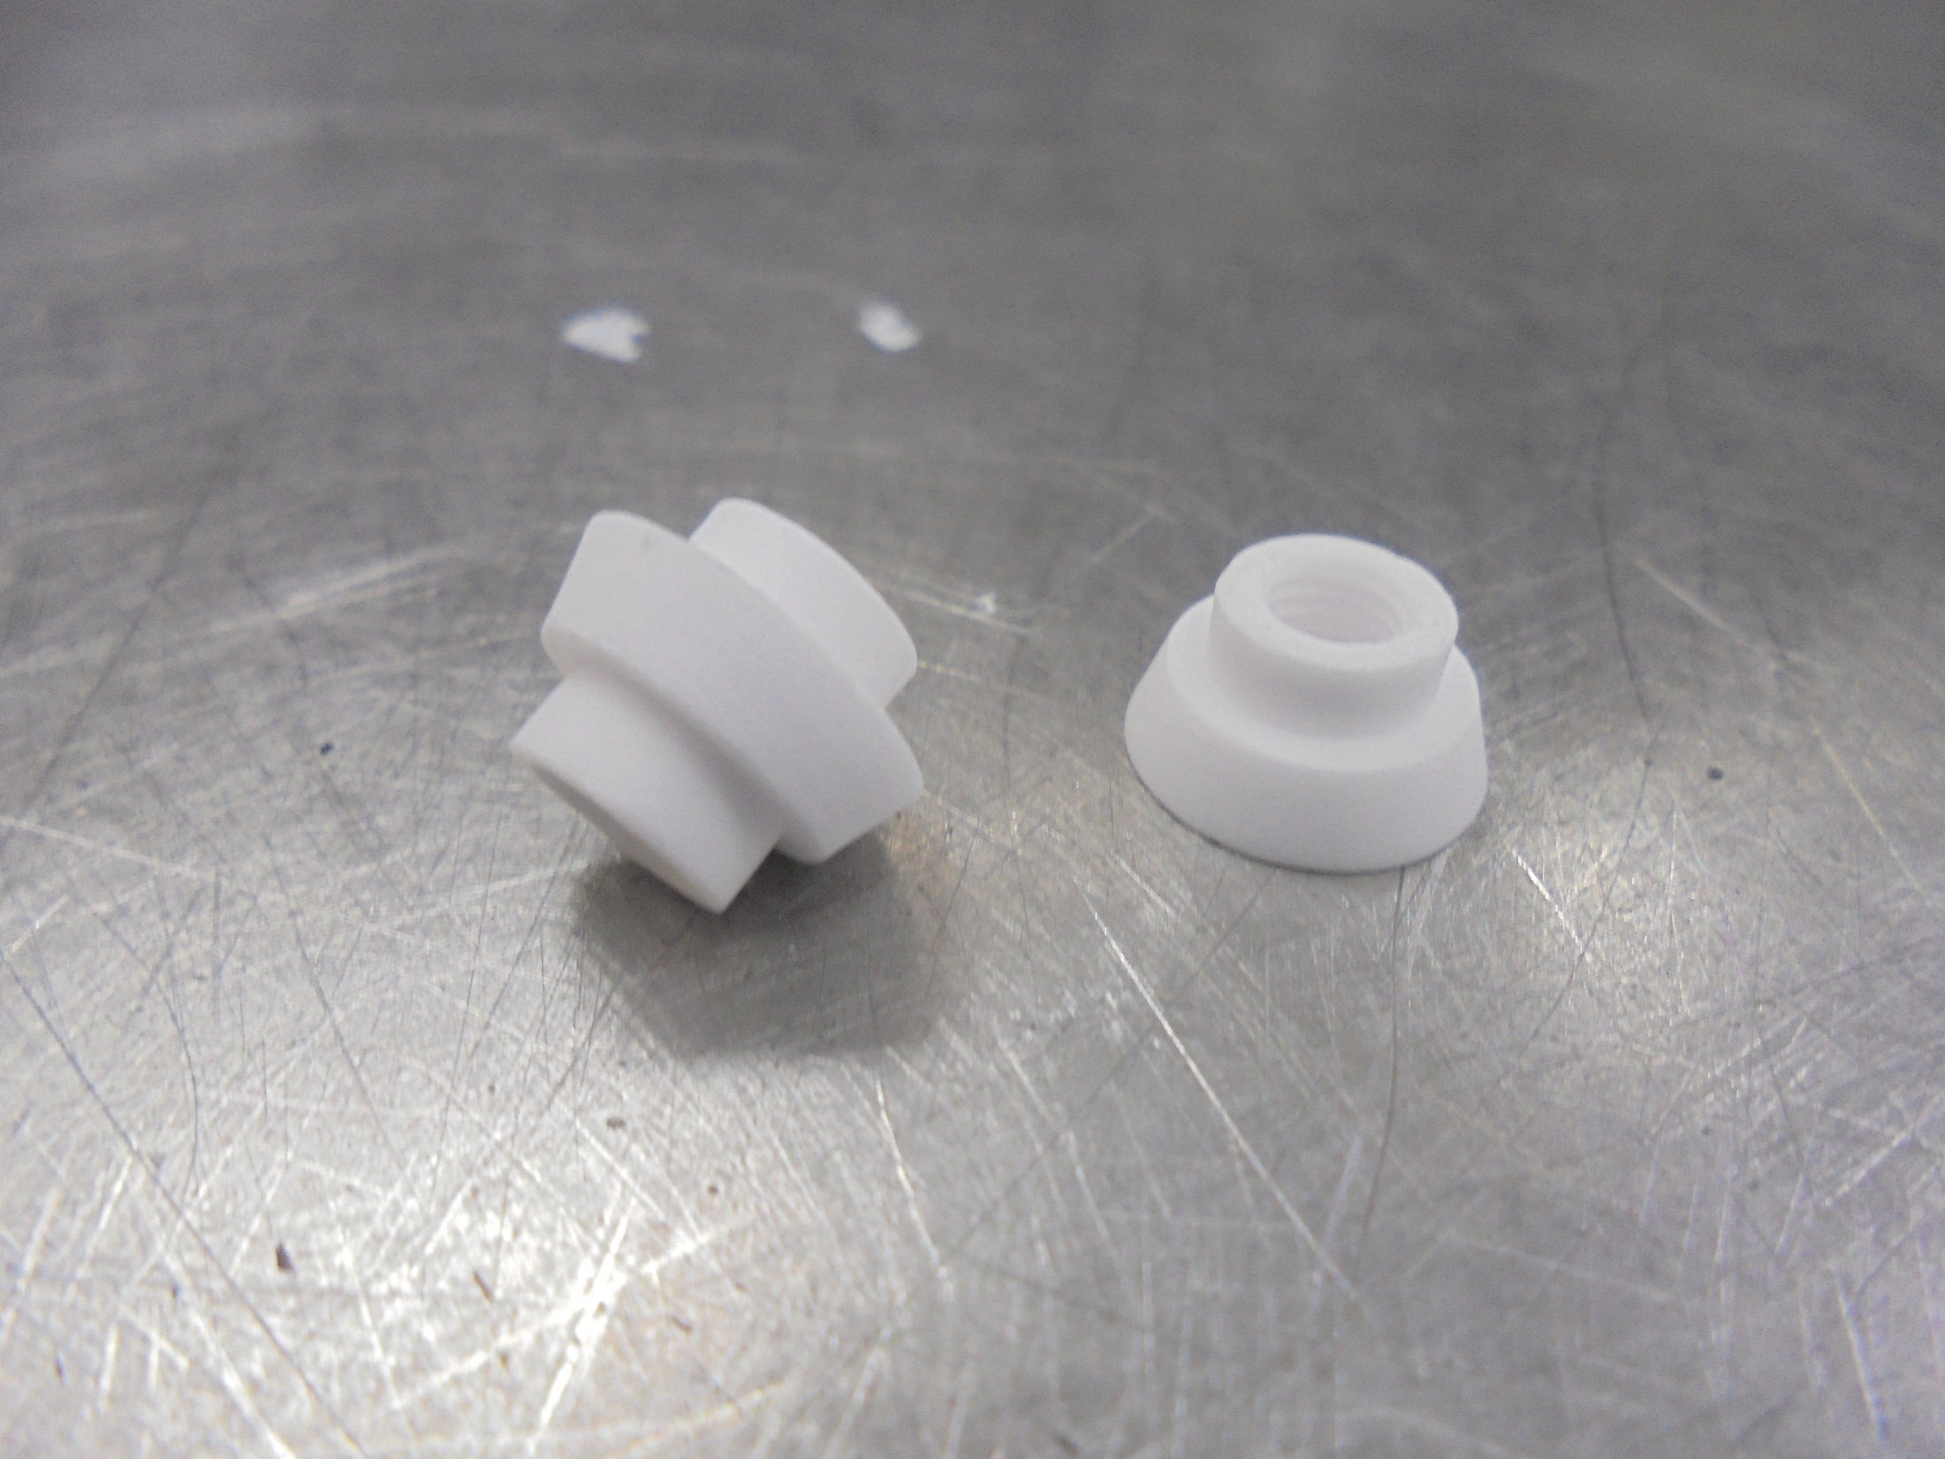
REPELLER INSULATOR (CERAMIC)

Slide 7
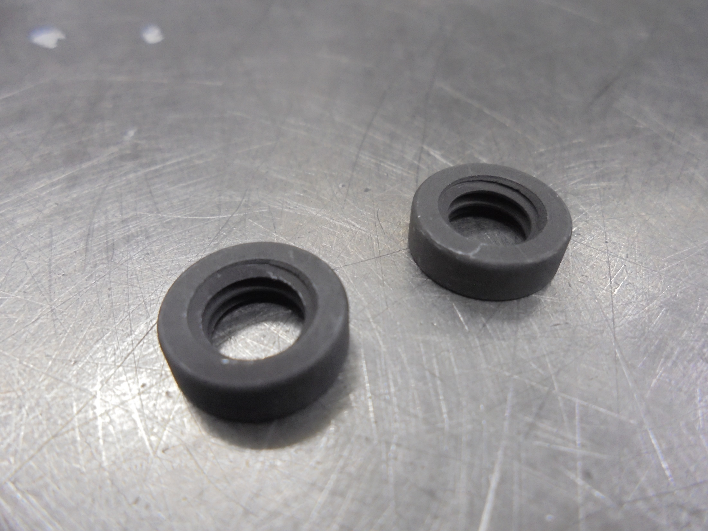
INSULATOR NUT (GRAPHITE)

Slide 8
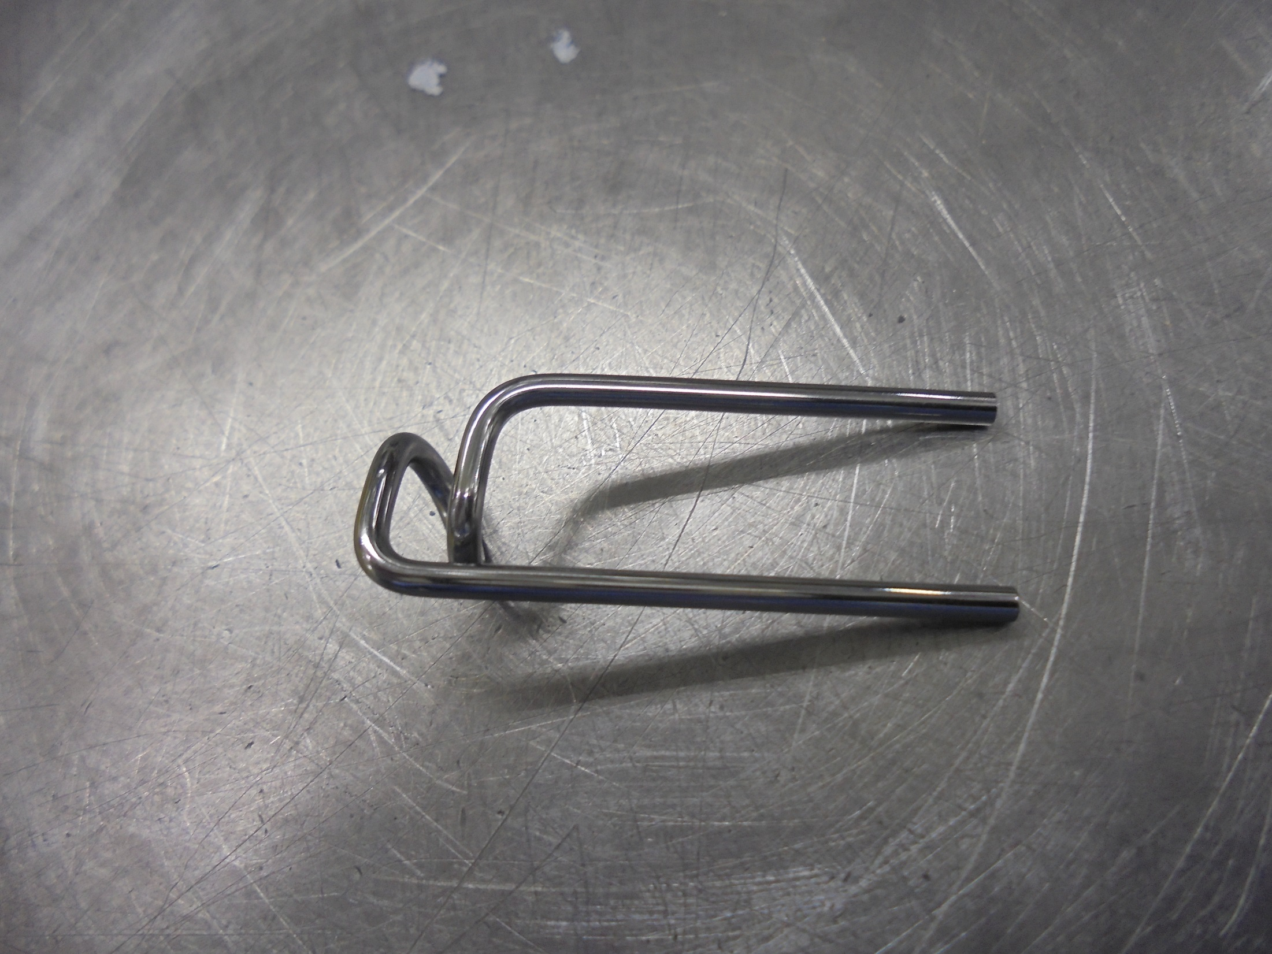
FILAMENT

Slide 9
Assembly

Slide 10
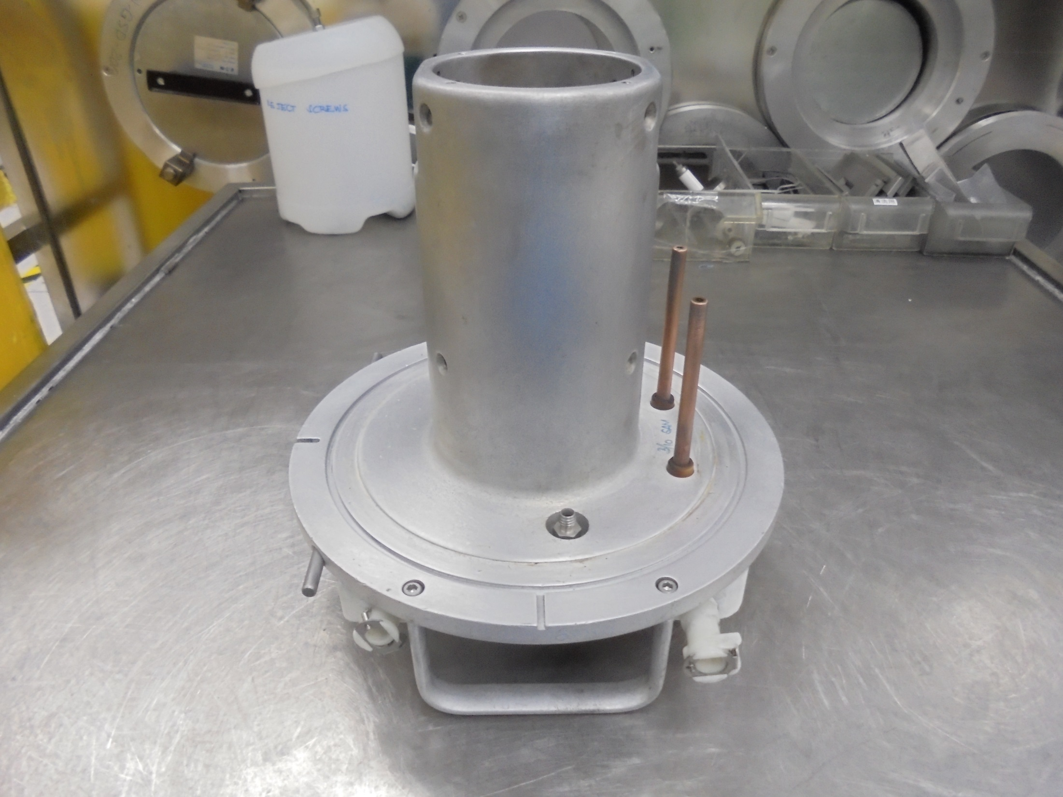
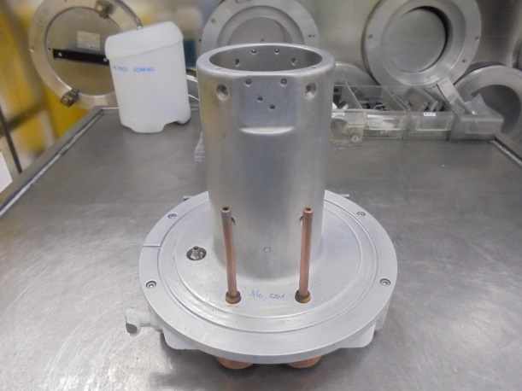
Filament FEEDTHRU ROD
E500 SOURCE HEAD BODY

Slide 11
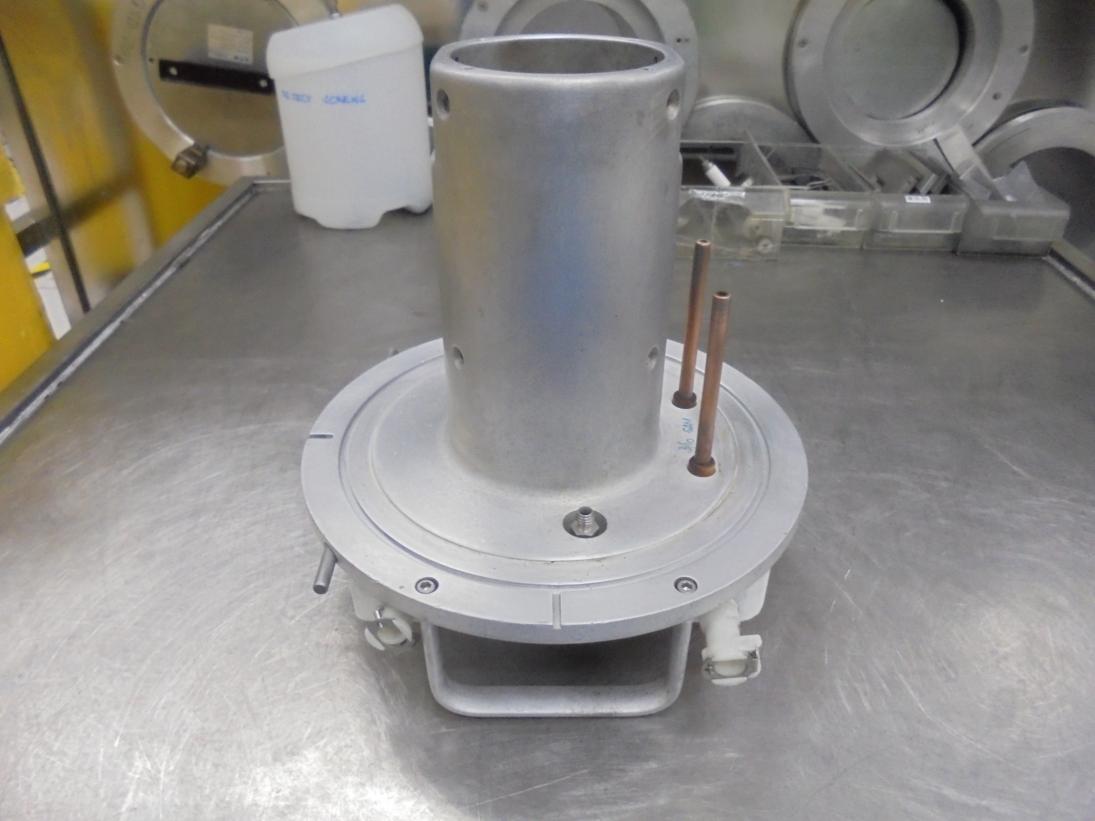
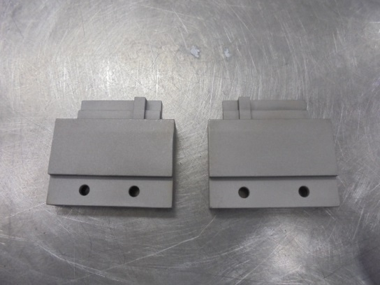
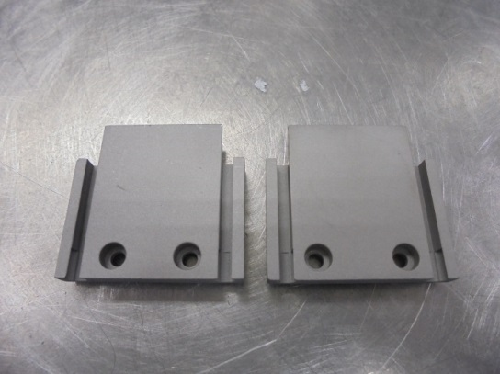
UPPER/LOWER
SUPPORT PLATE
Install
Inner Face
Outer Face

Slide 12
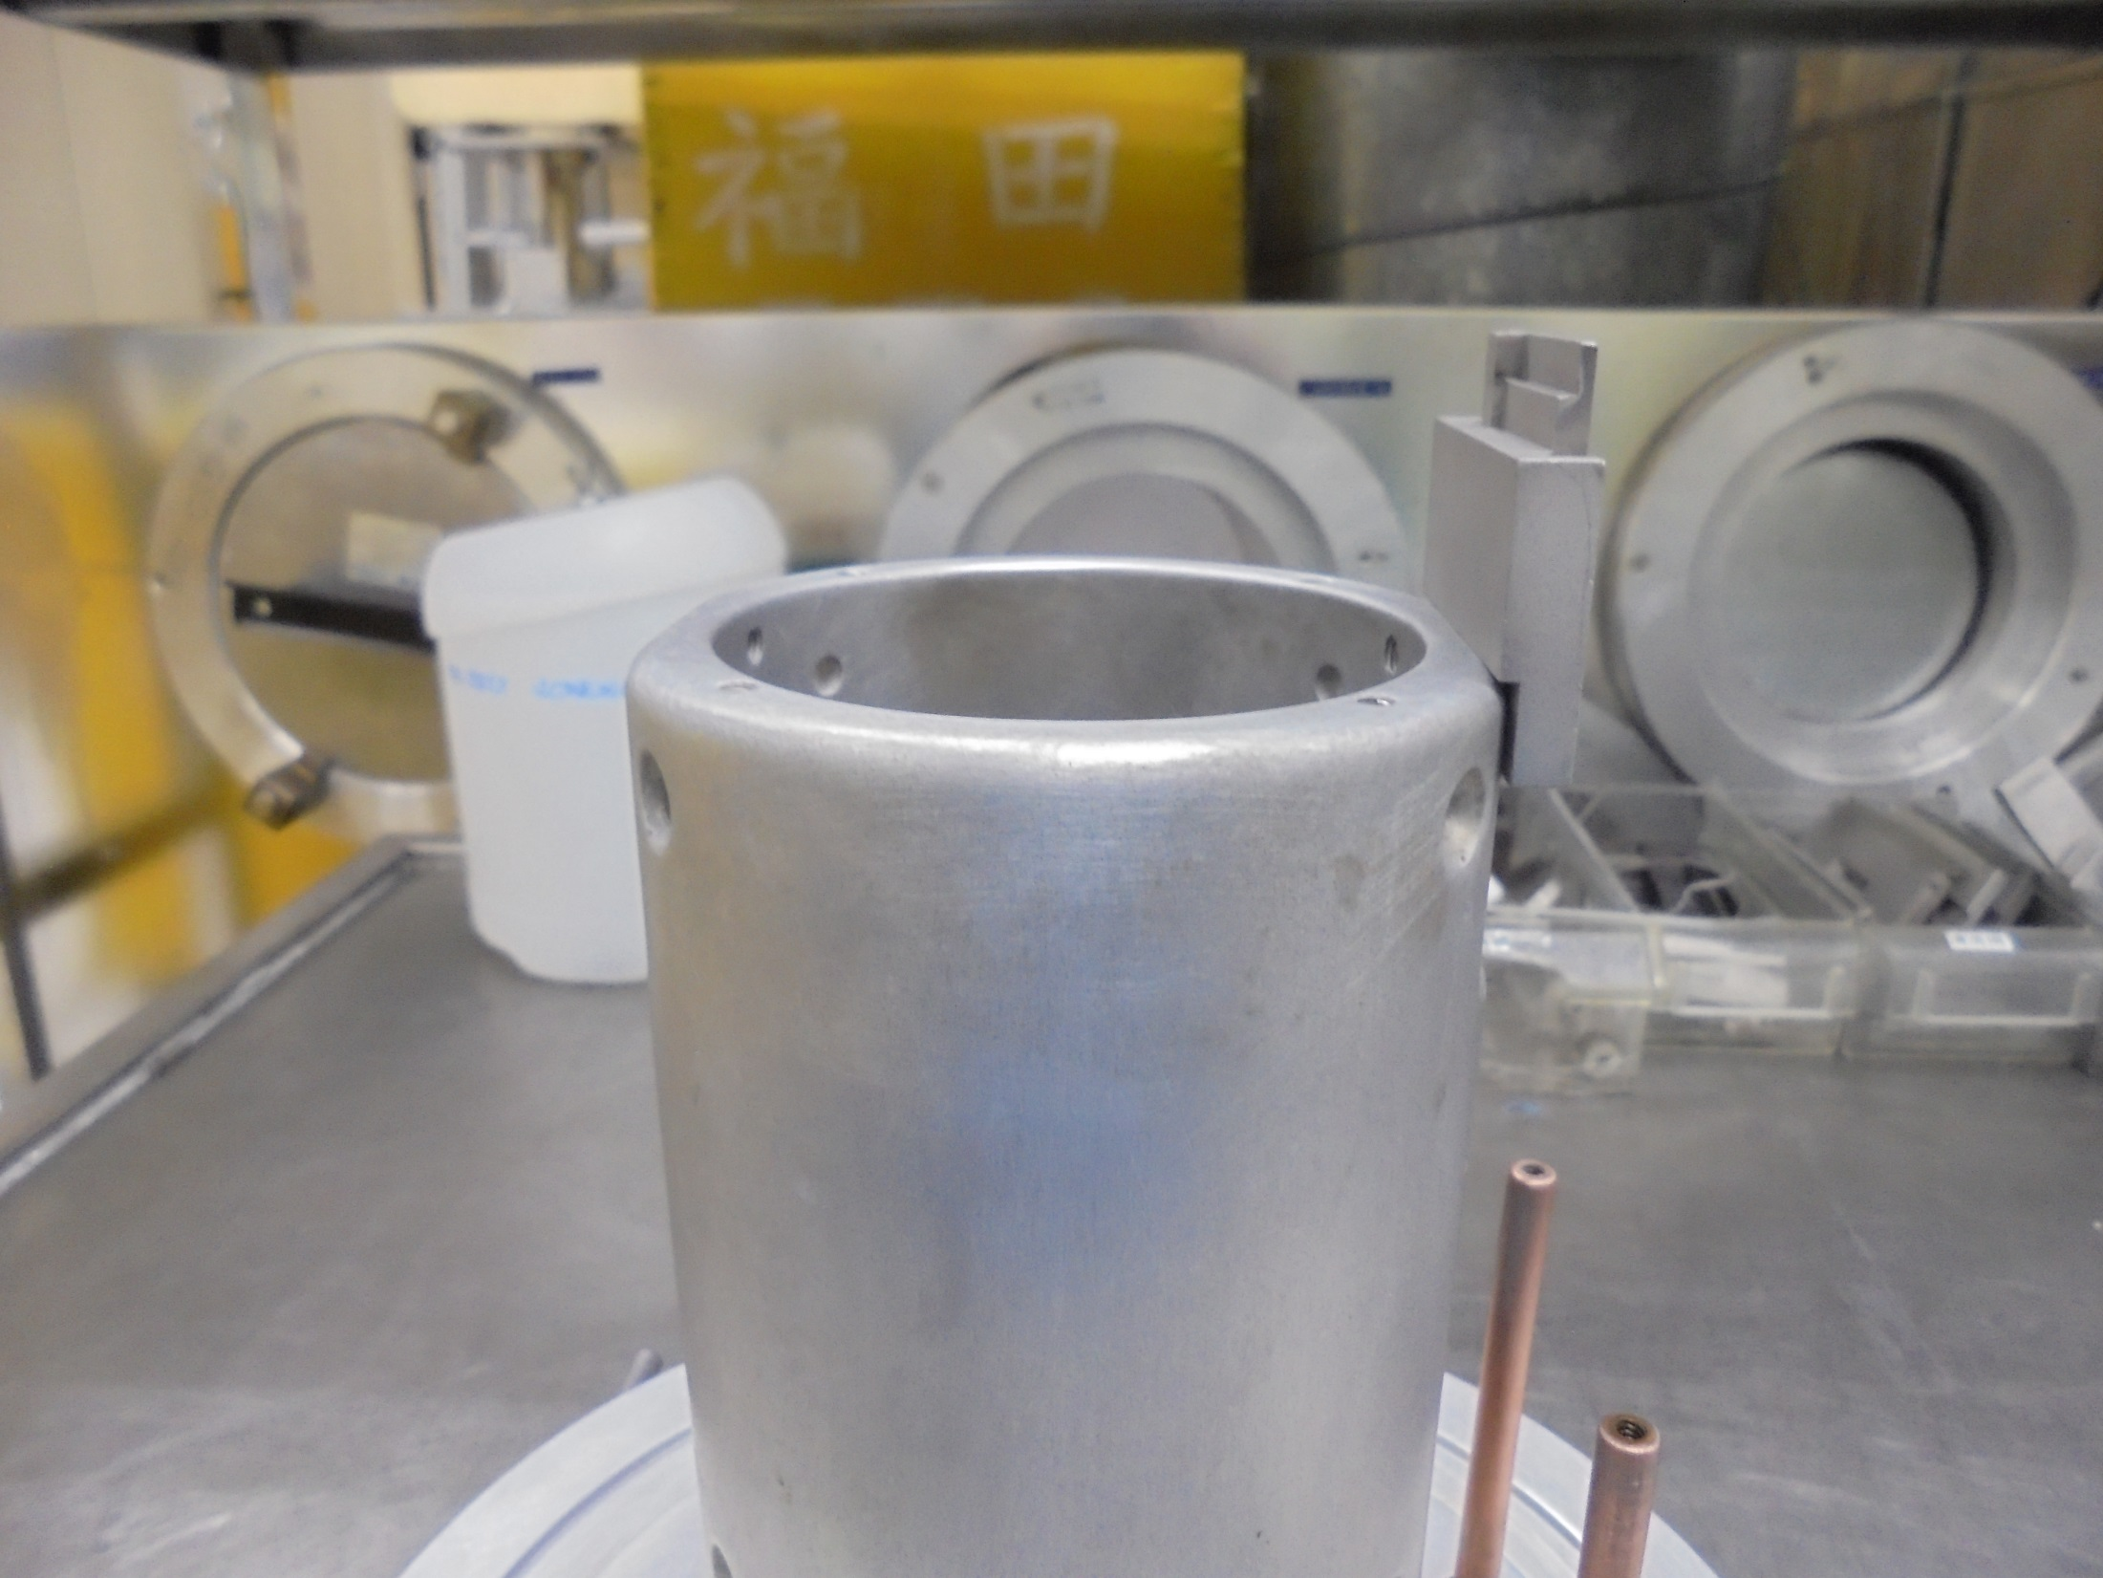
Install UPPER Support
(Secure Tight Screws)

Slide 13
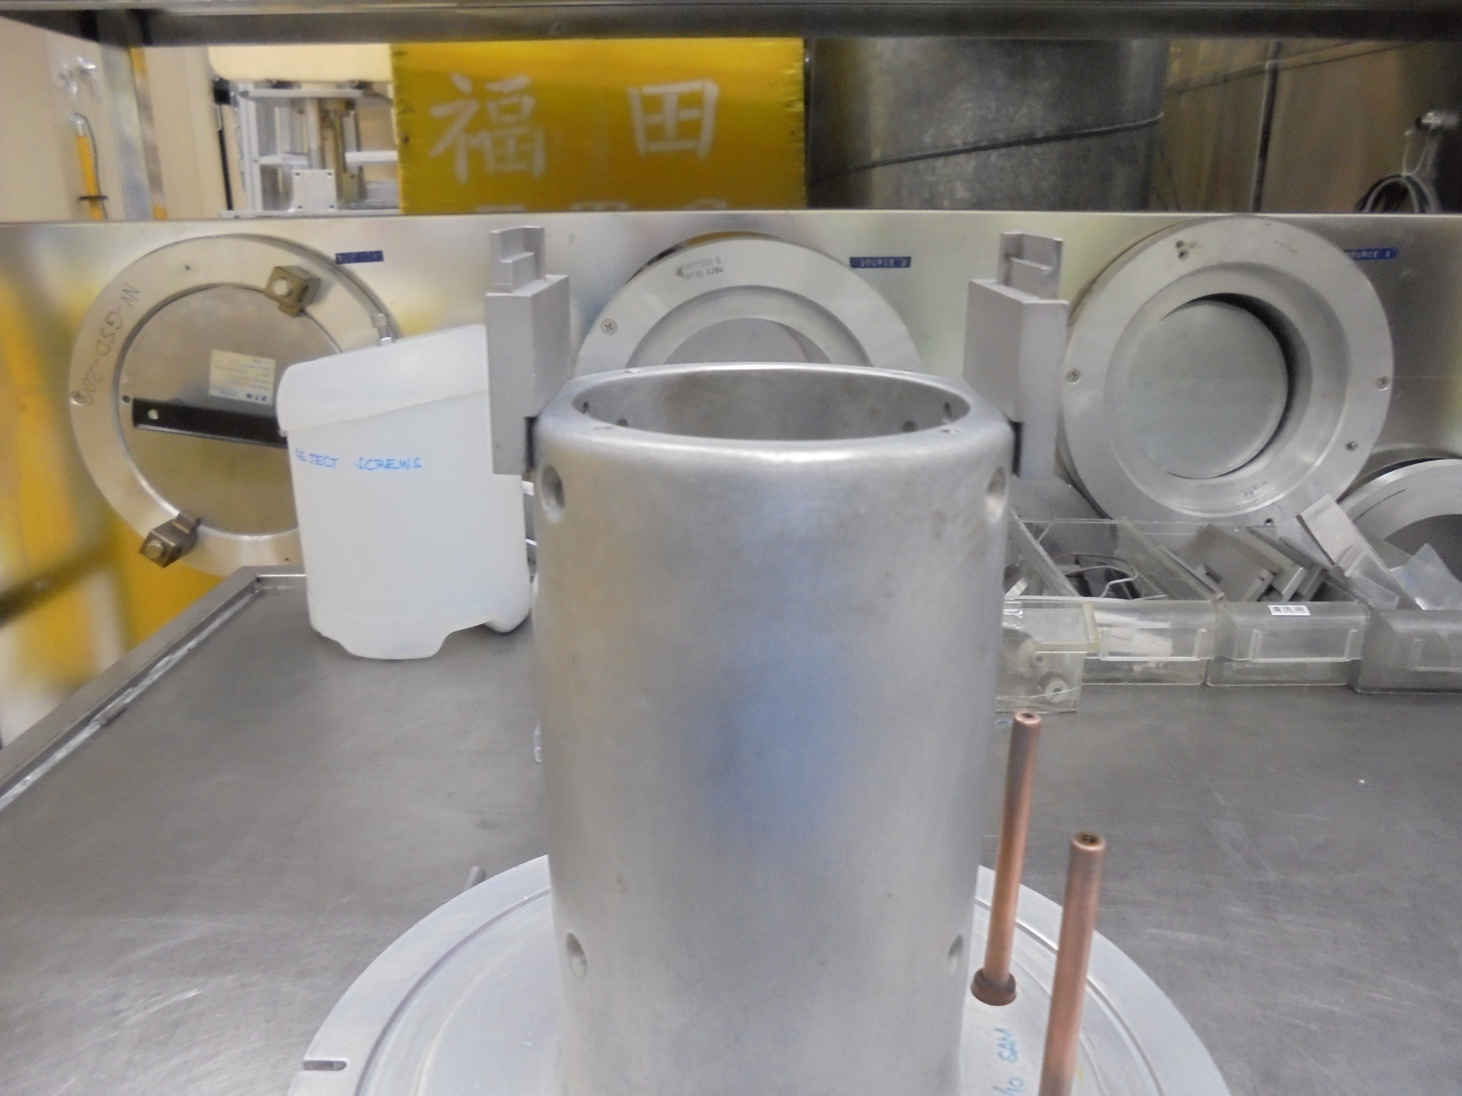
Install LOWER Support
(Secure Tight Screws)

Slide 14
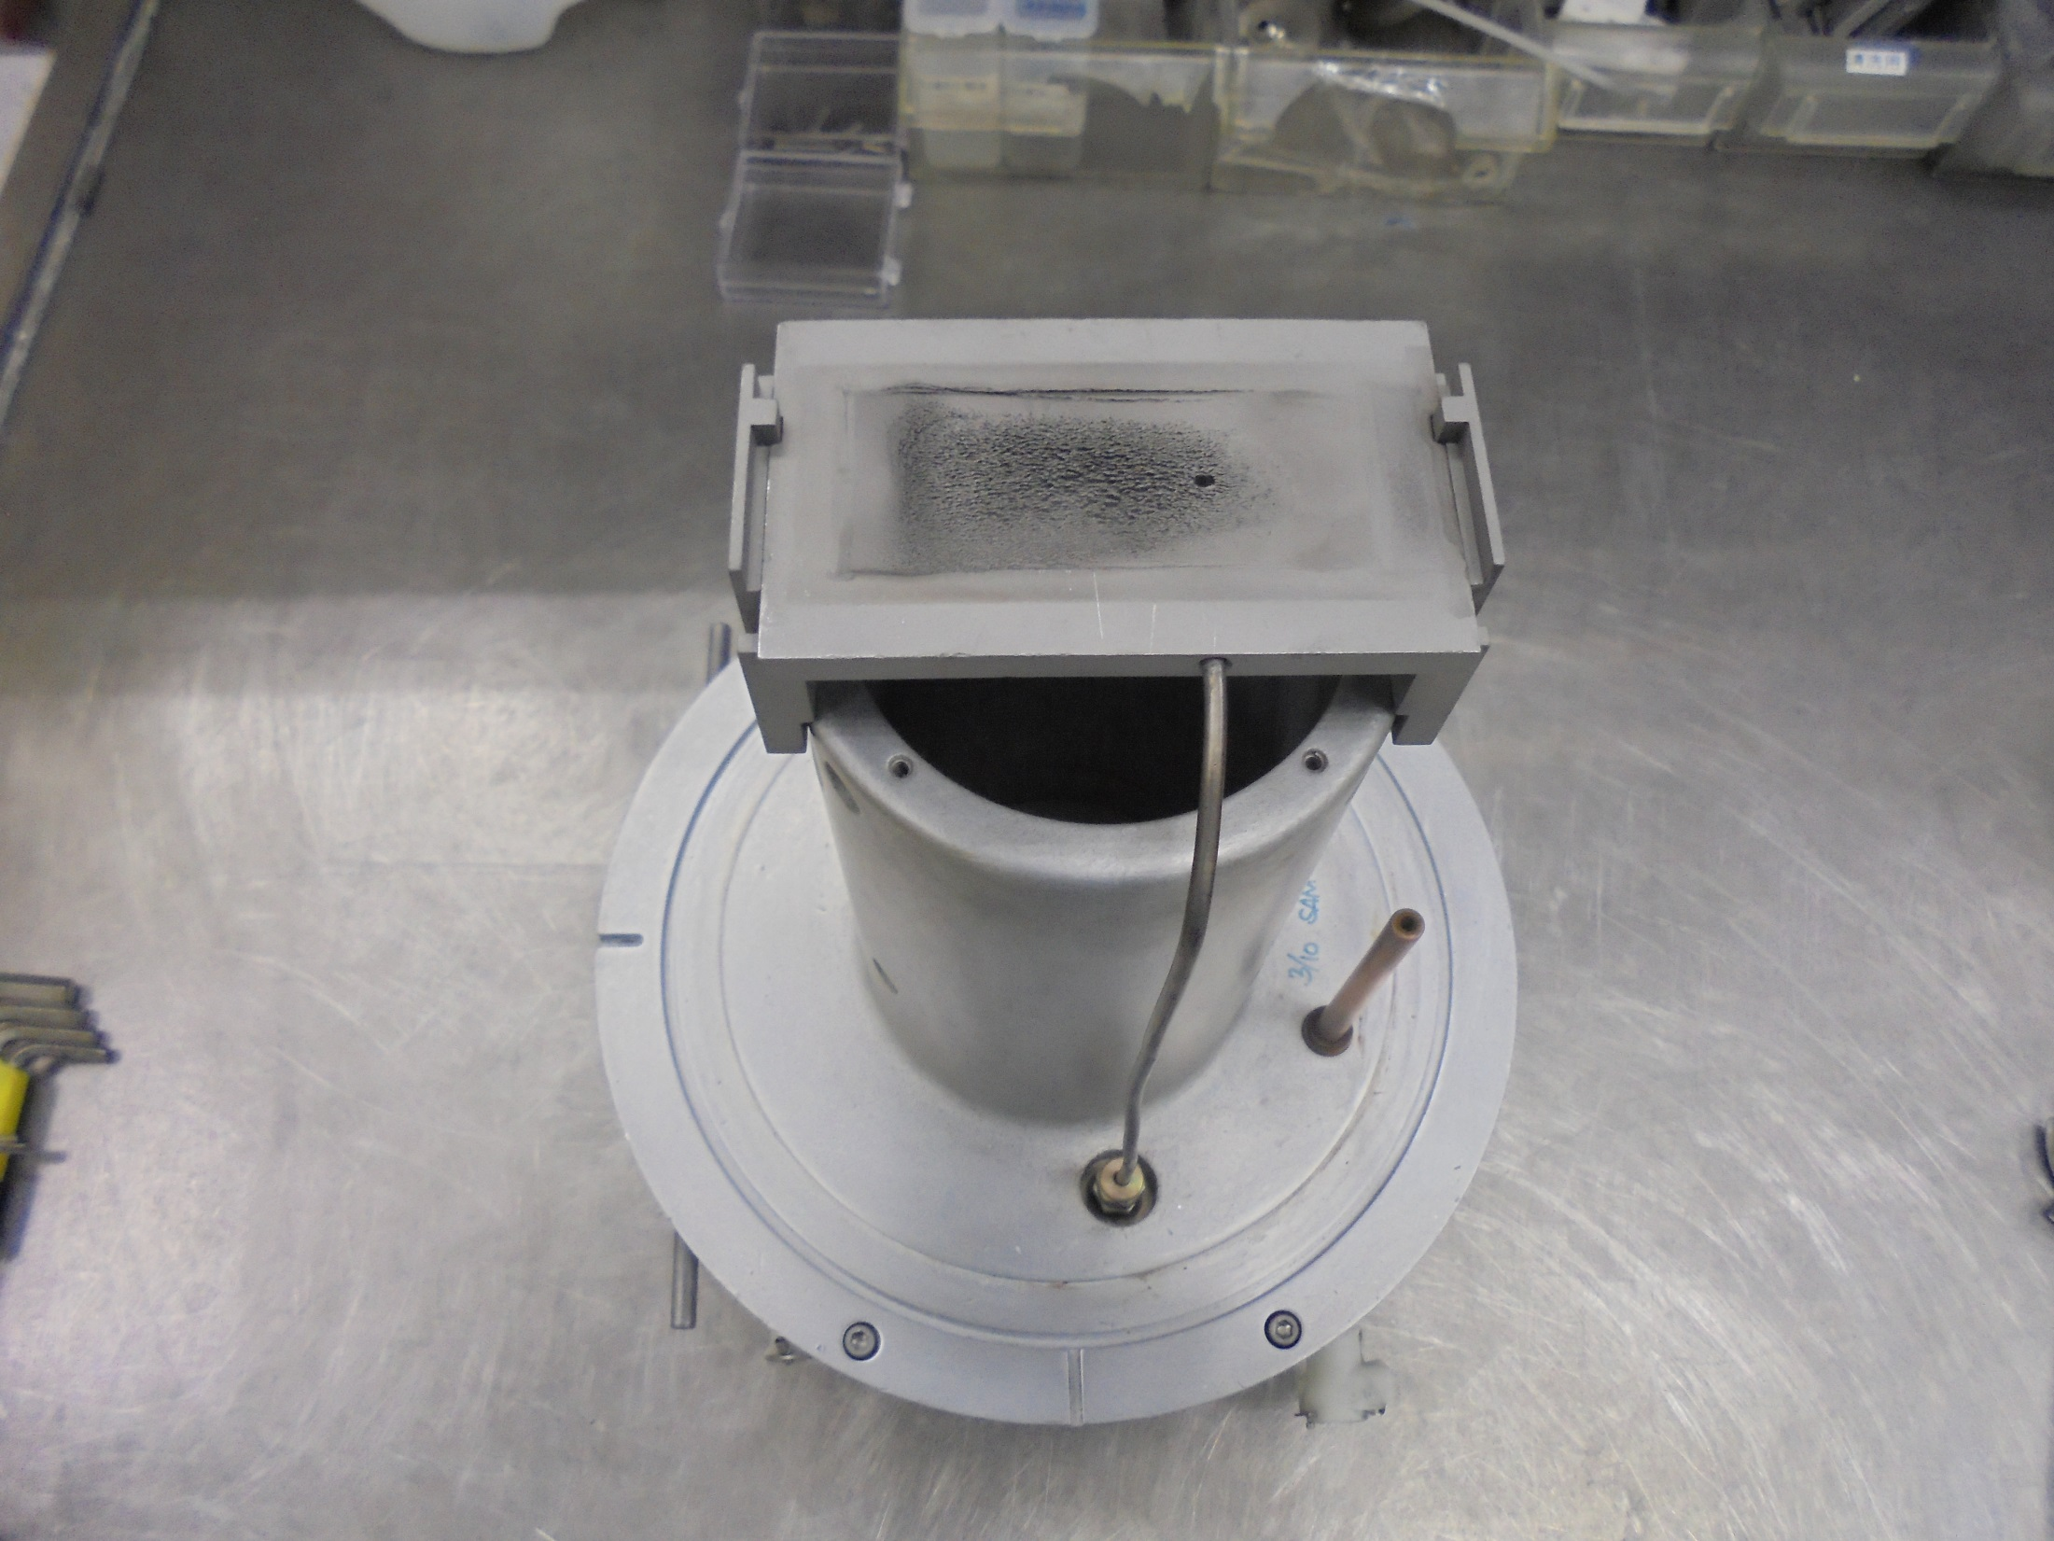
*Notice: Pay Attention On Proper
Orientation Of Locator Slot While
Installing The UPPER/LOWER
SUPPORT Plate …
Gas Hole
Install CHAMBER BOTTOM PLATE
Gas Feed Tube
Filament FeedThru Rod (+)

Slide 15
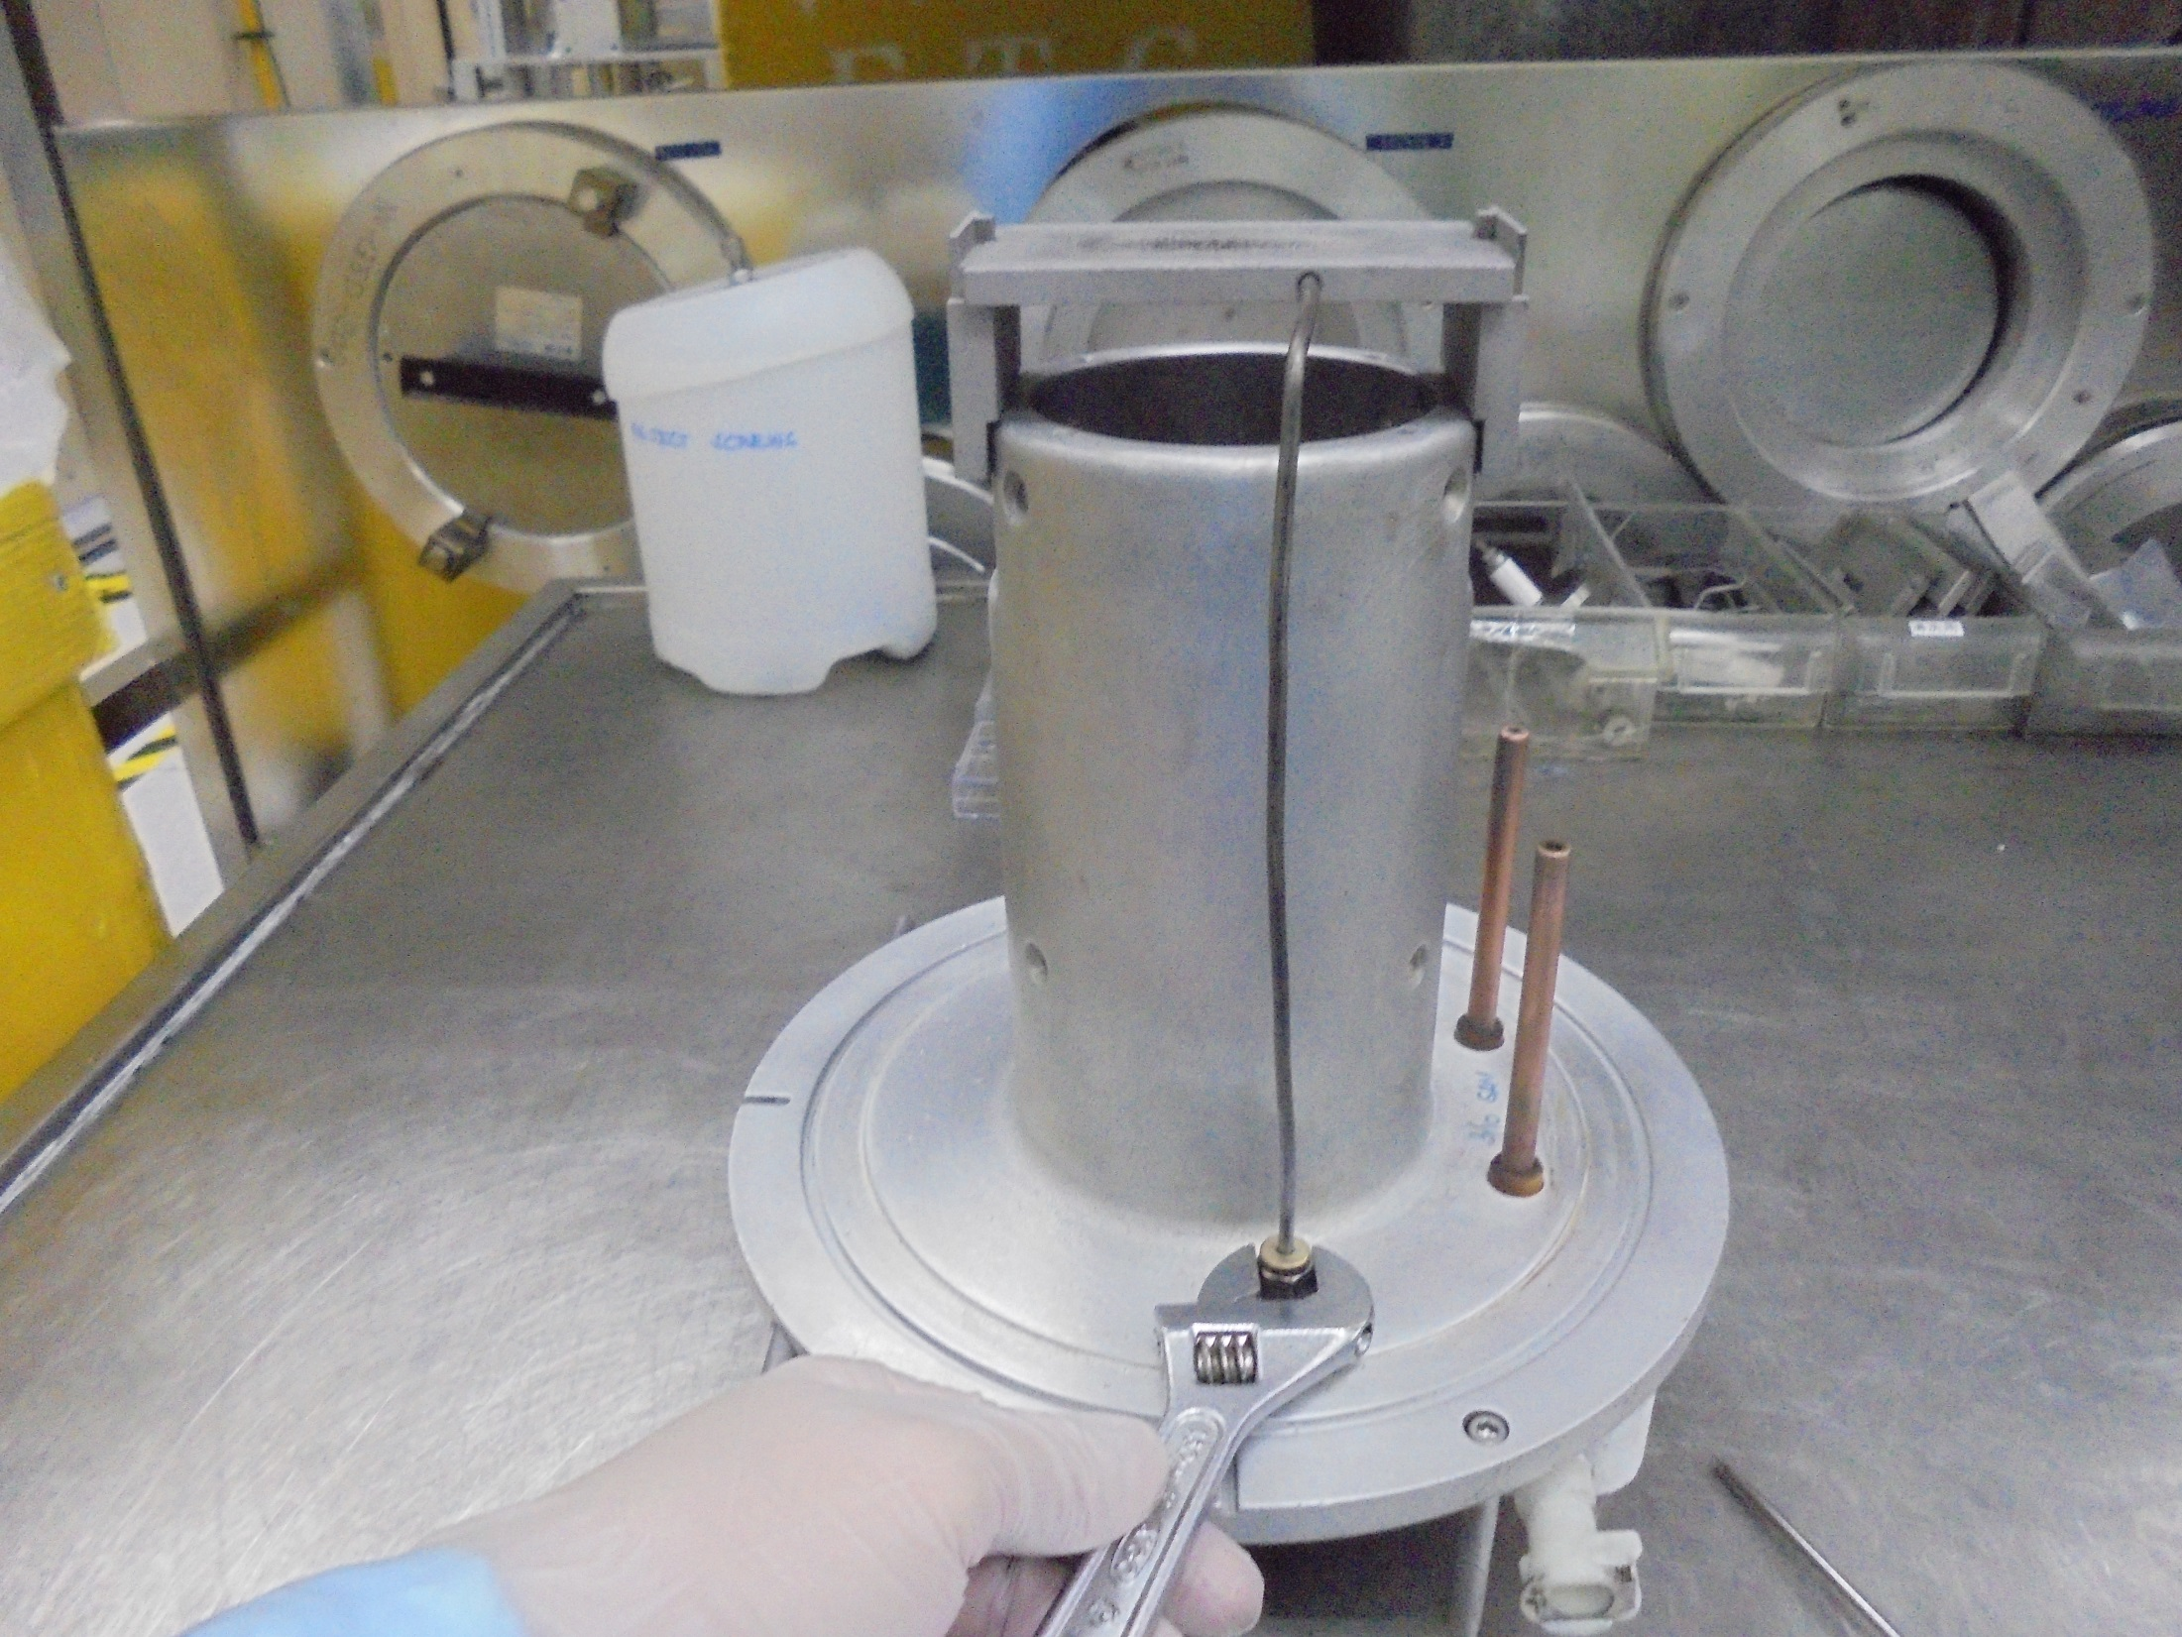
Tighten SUS

Slide 16
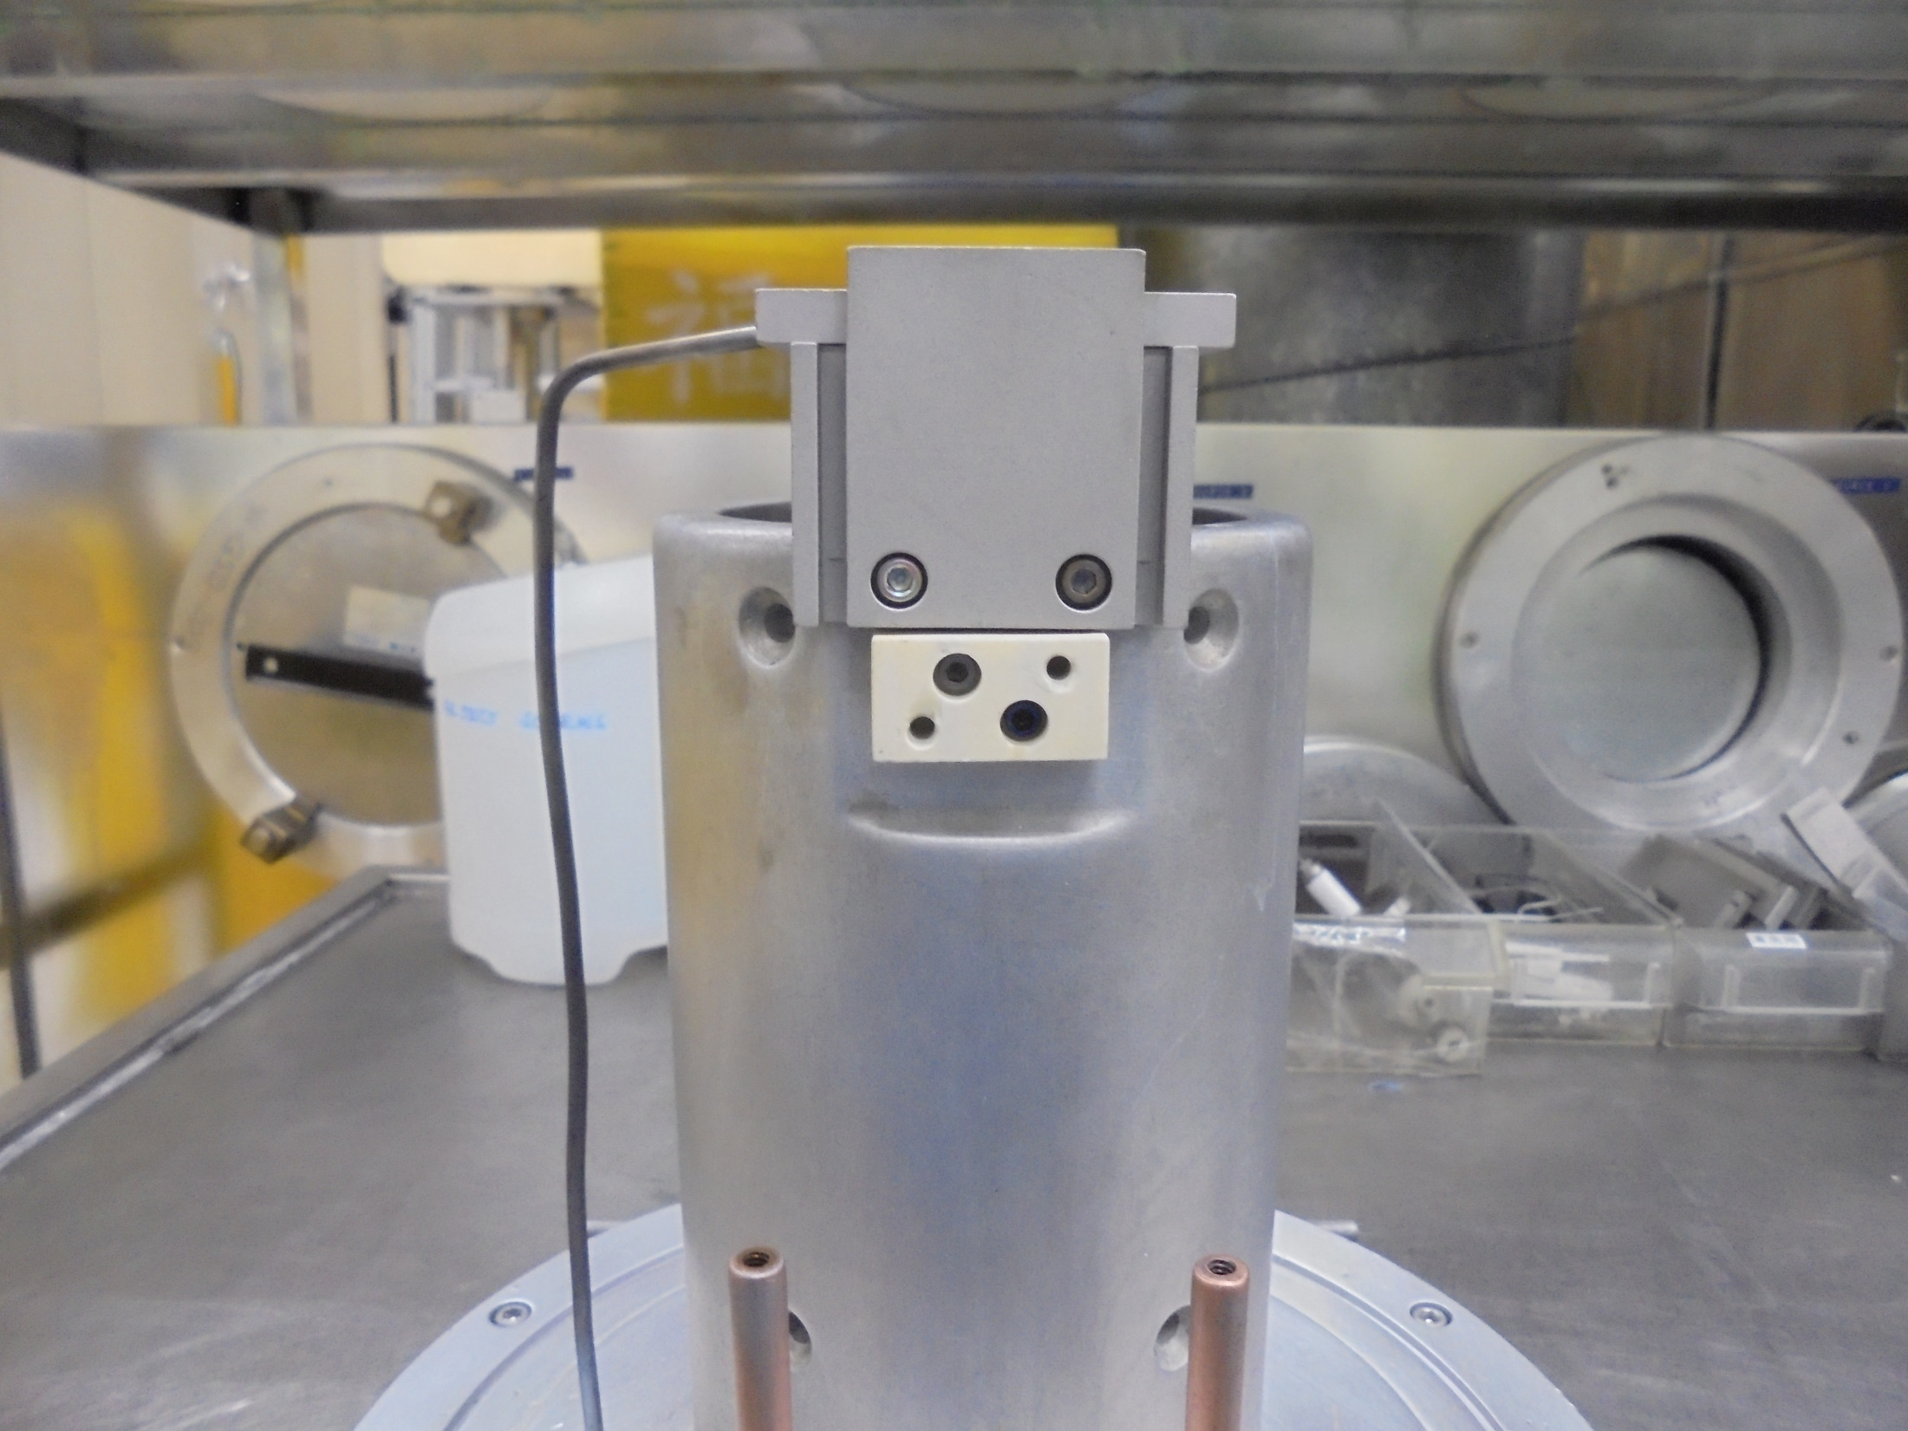
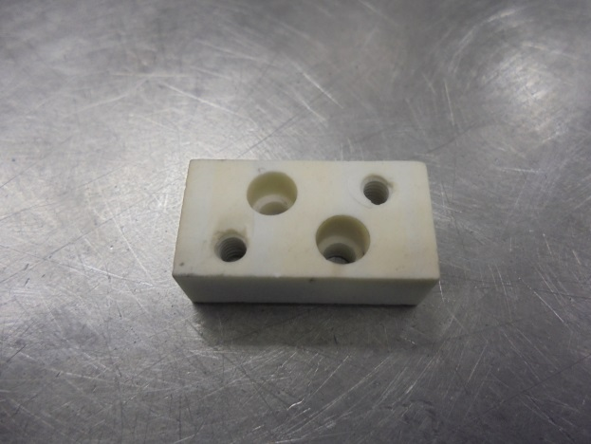
Filament Clamp Insulator
Install Here!

Slide 17
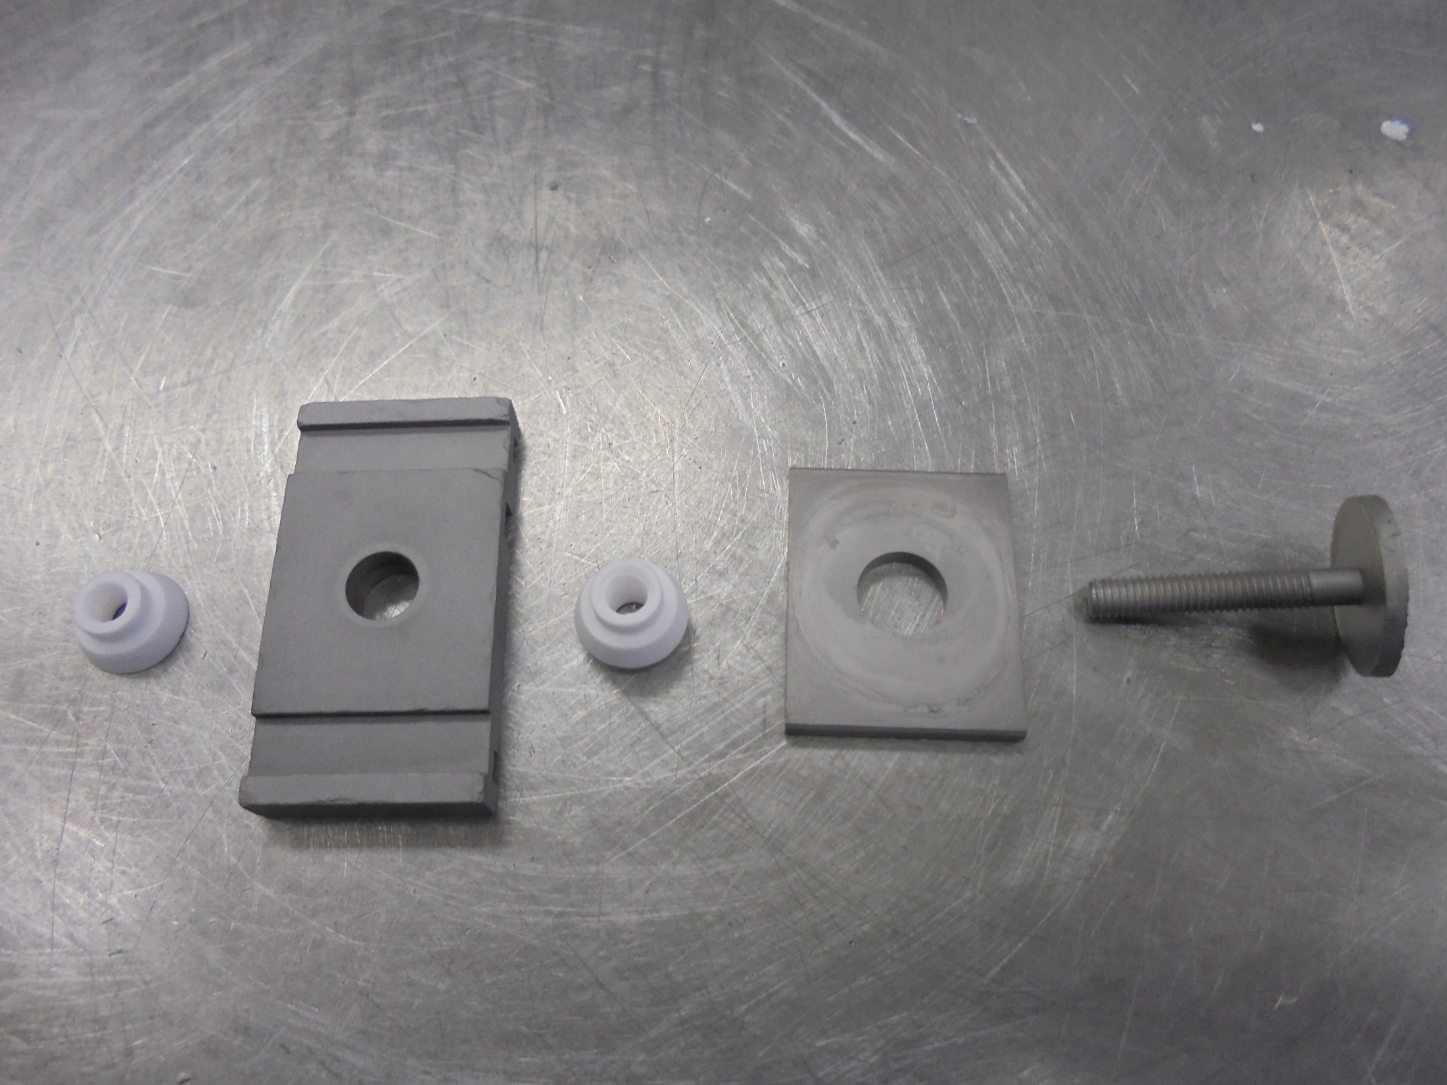
ASSEMBLE THE FOLLOWING REFLECTOR END COMPONENTS:
CERAMIC INSULATOR
REPELLER
BOTTOM SHIELD END PLATE
BOTTOM END CAP PLATE

Slide 18
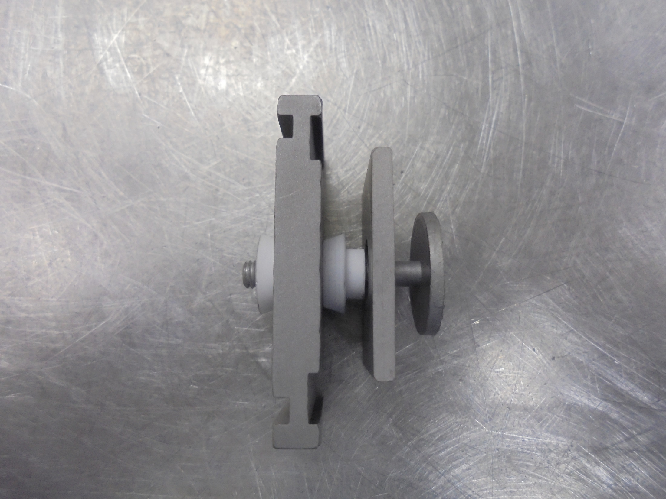
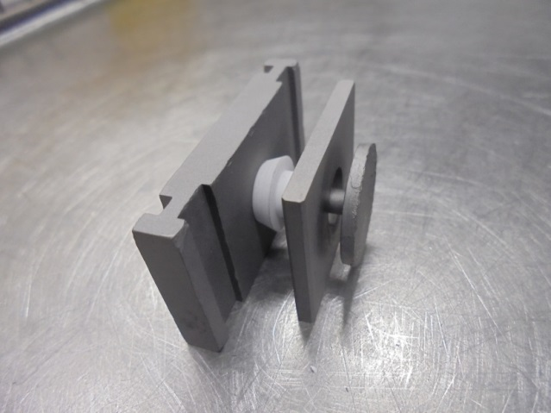
REFLECTOR END
Slot For
SIDE PLATES

Slide 19
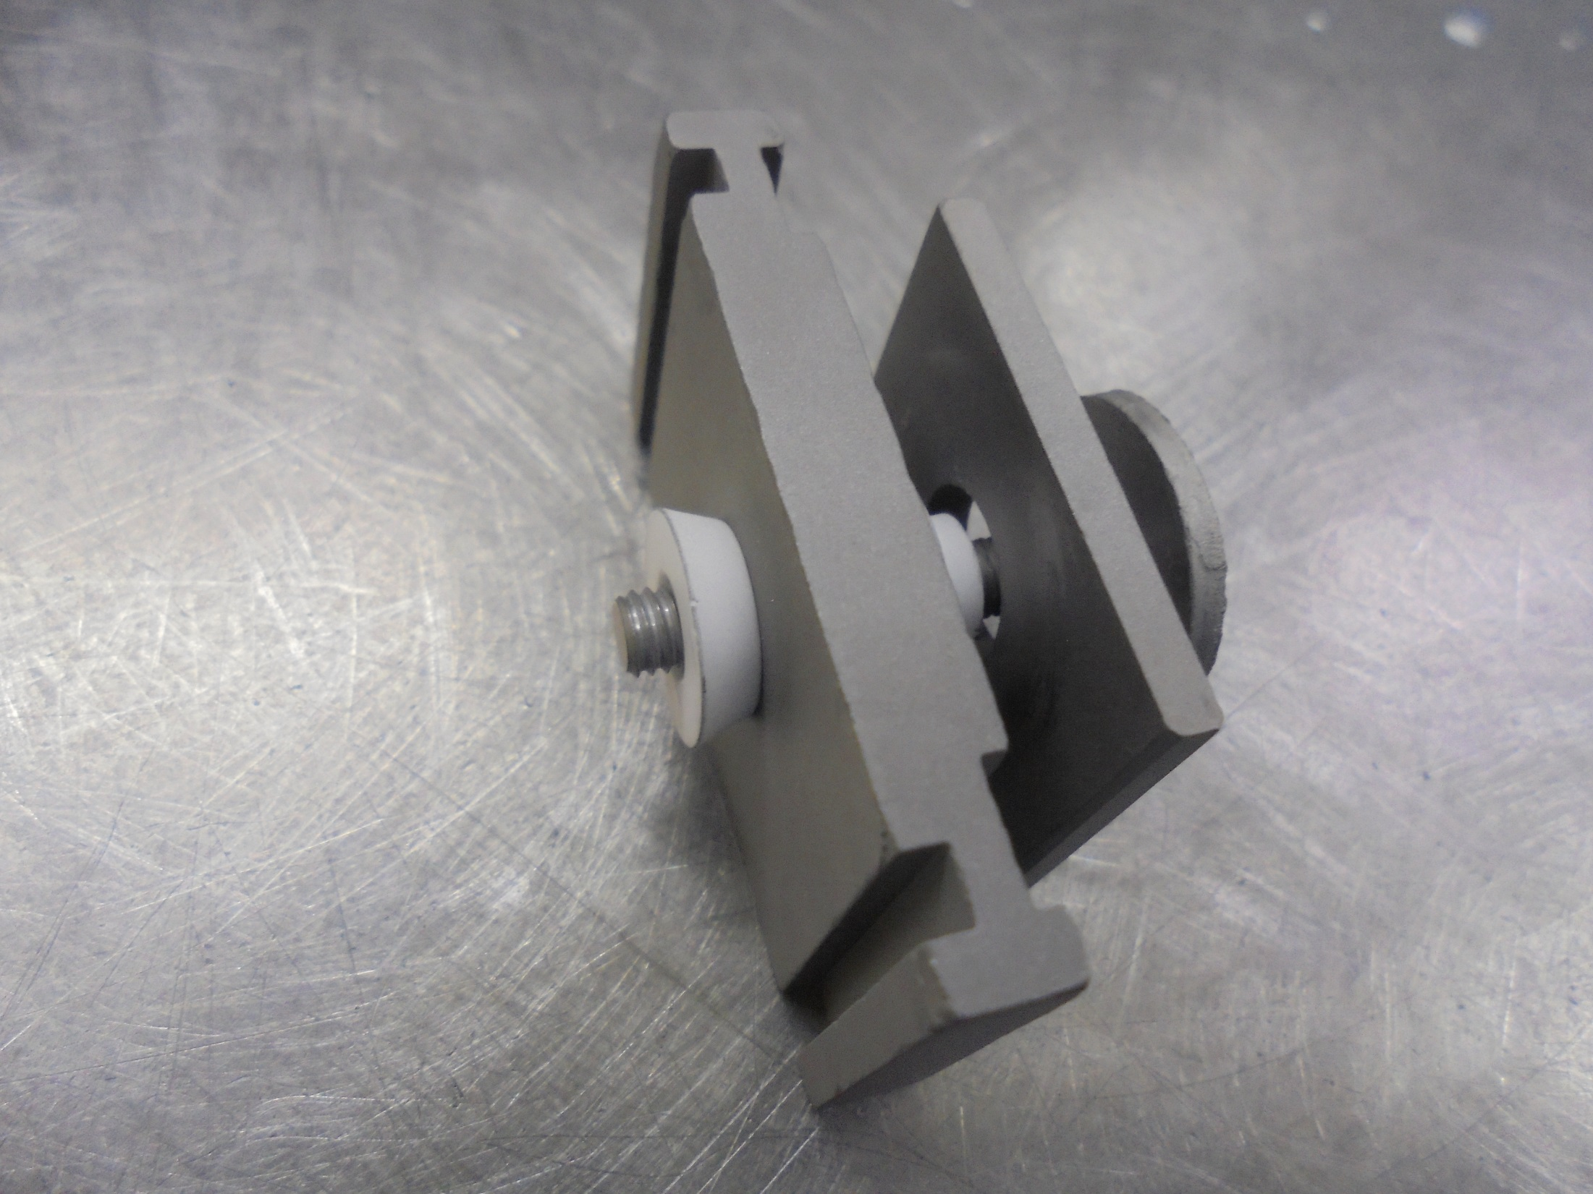
*Notice: At Least 3 Lines Of Thread
Protrude (alignment matter)

Slide 20
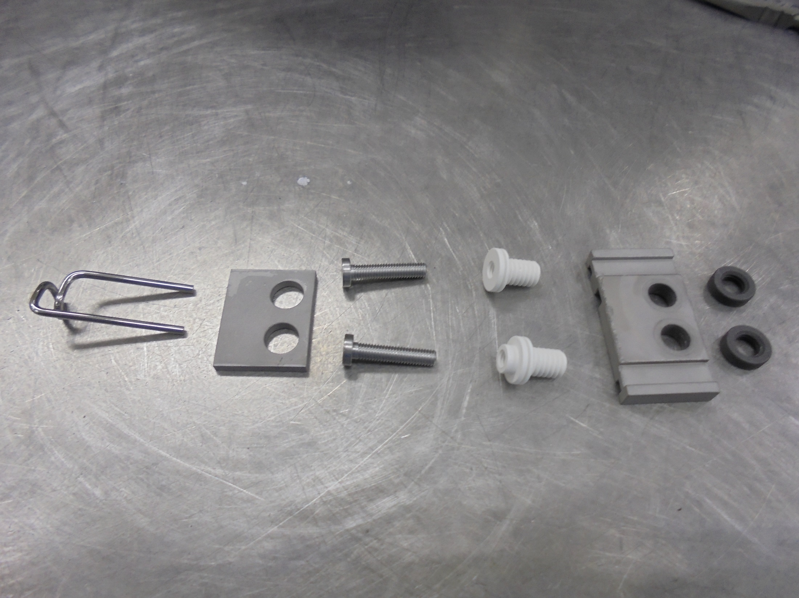
ASSEMBLE THE FOLLOWING FILAMENT END PLATE COMPONENTS:
FILAMENT
FILAMENT SHIELD
FILAMENT SCREW
FILAMENT INSULATOR
END CAP PLATE
INSULATOR NUT

Slide 21
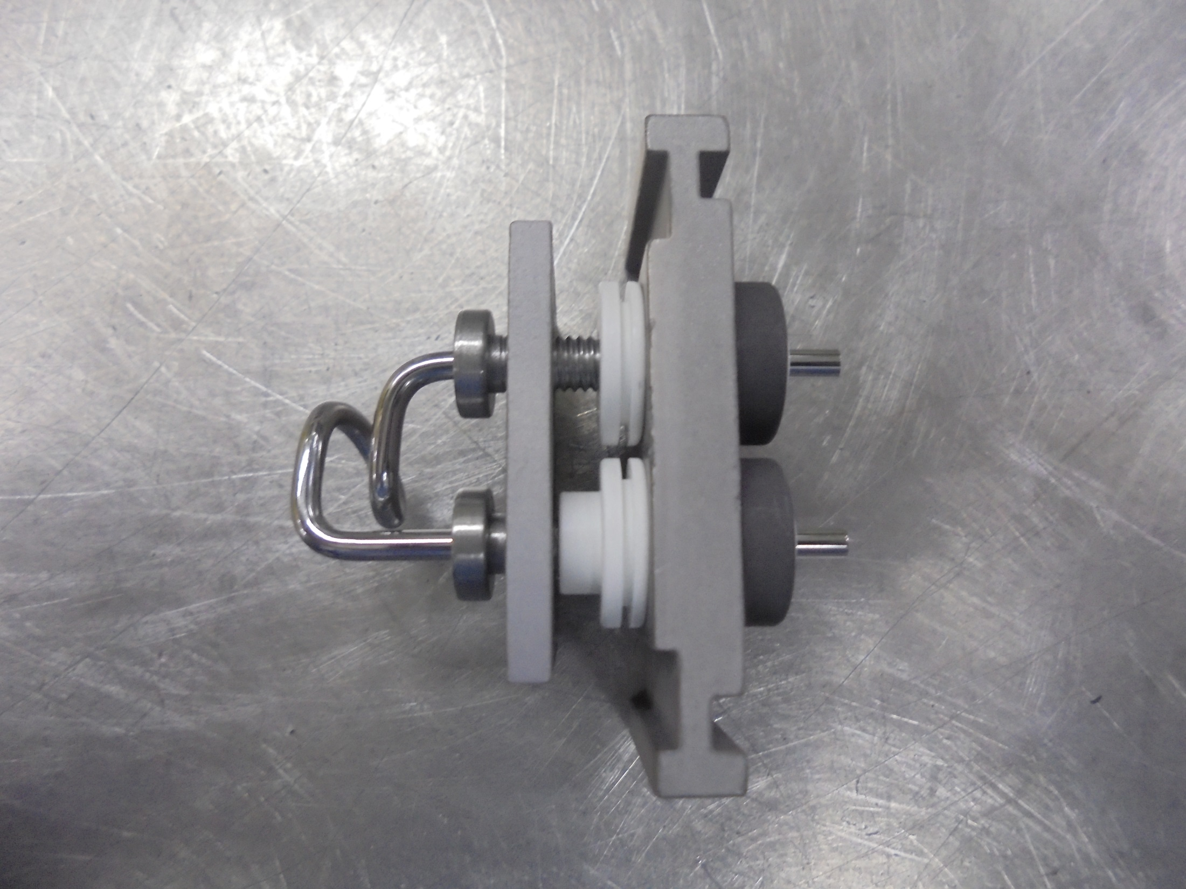
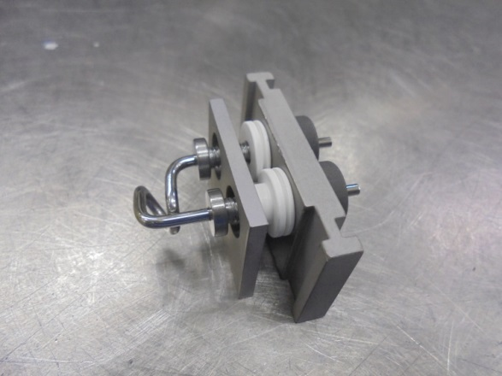
FILAMENT END PLATE
FILAMENT CLAMP Install Here!

Slide 22
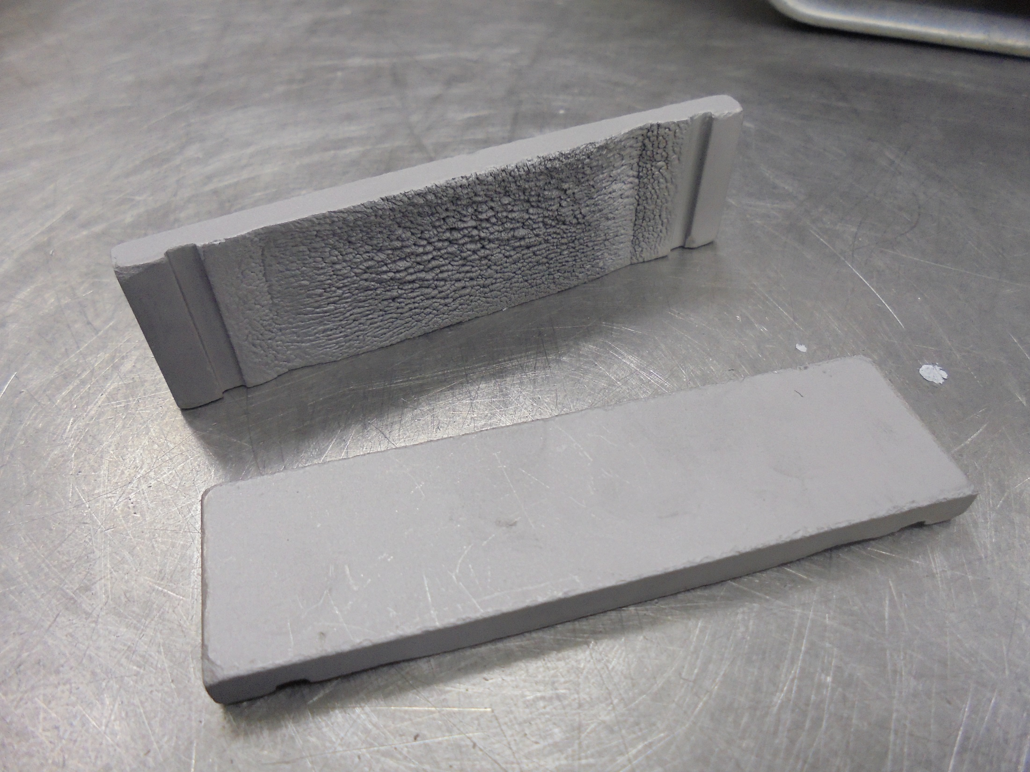
ARC CHAMBER SIDE PLATES

Slide 23
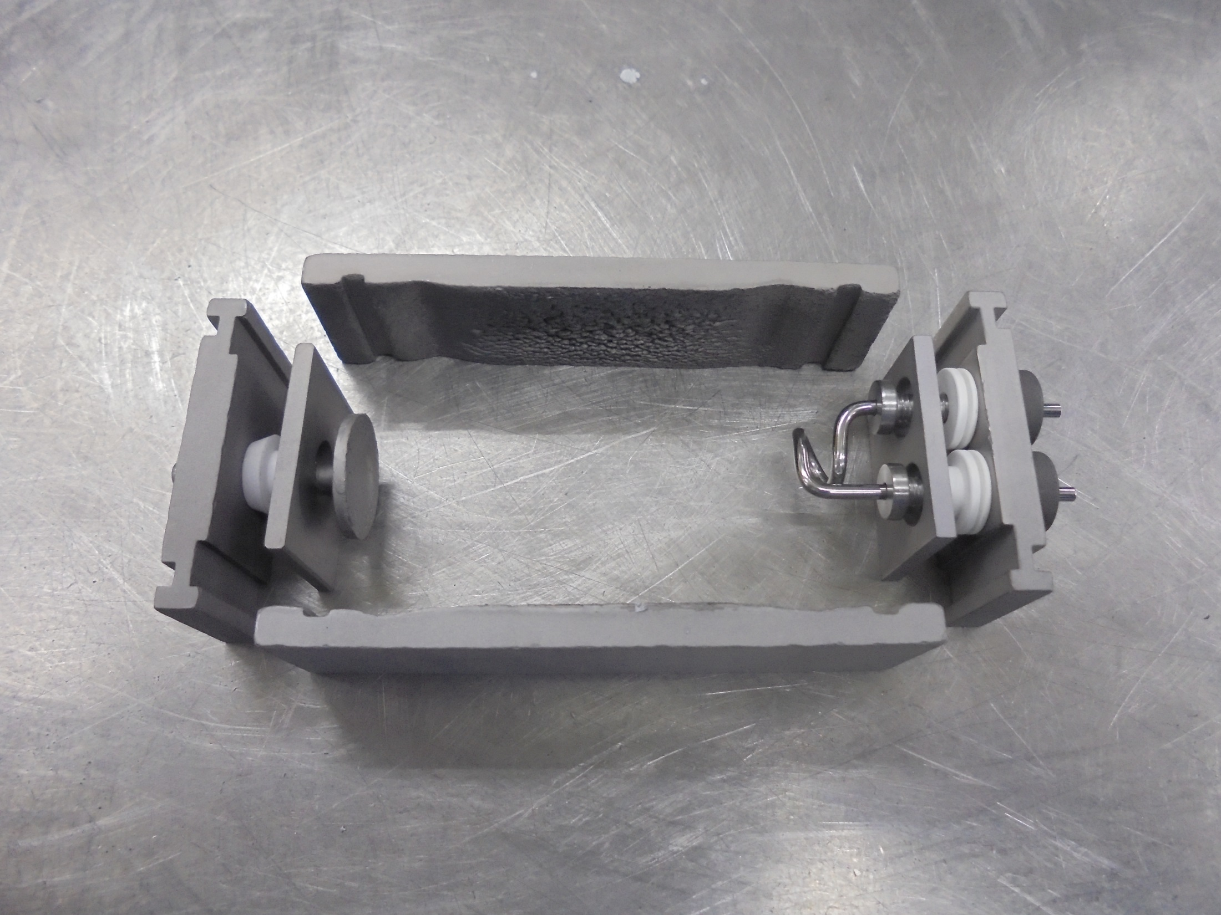
Assemble The Arc Chamber Parts…

Slide 24
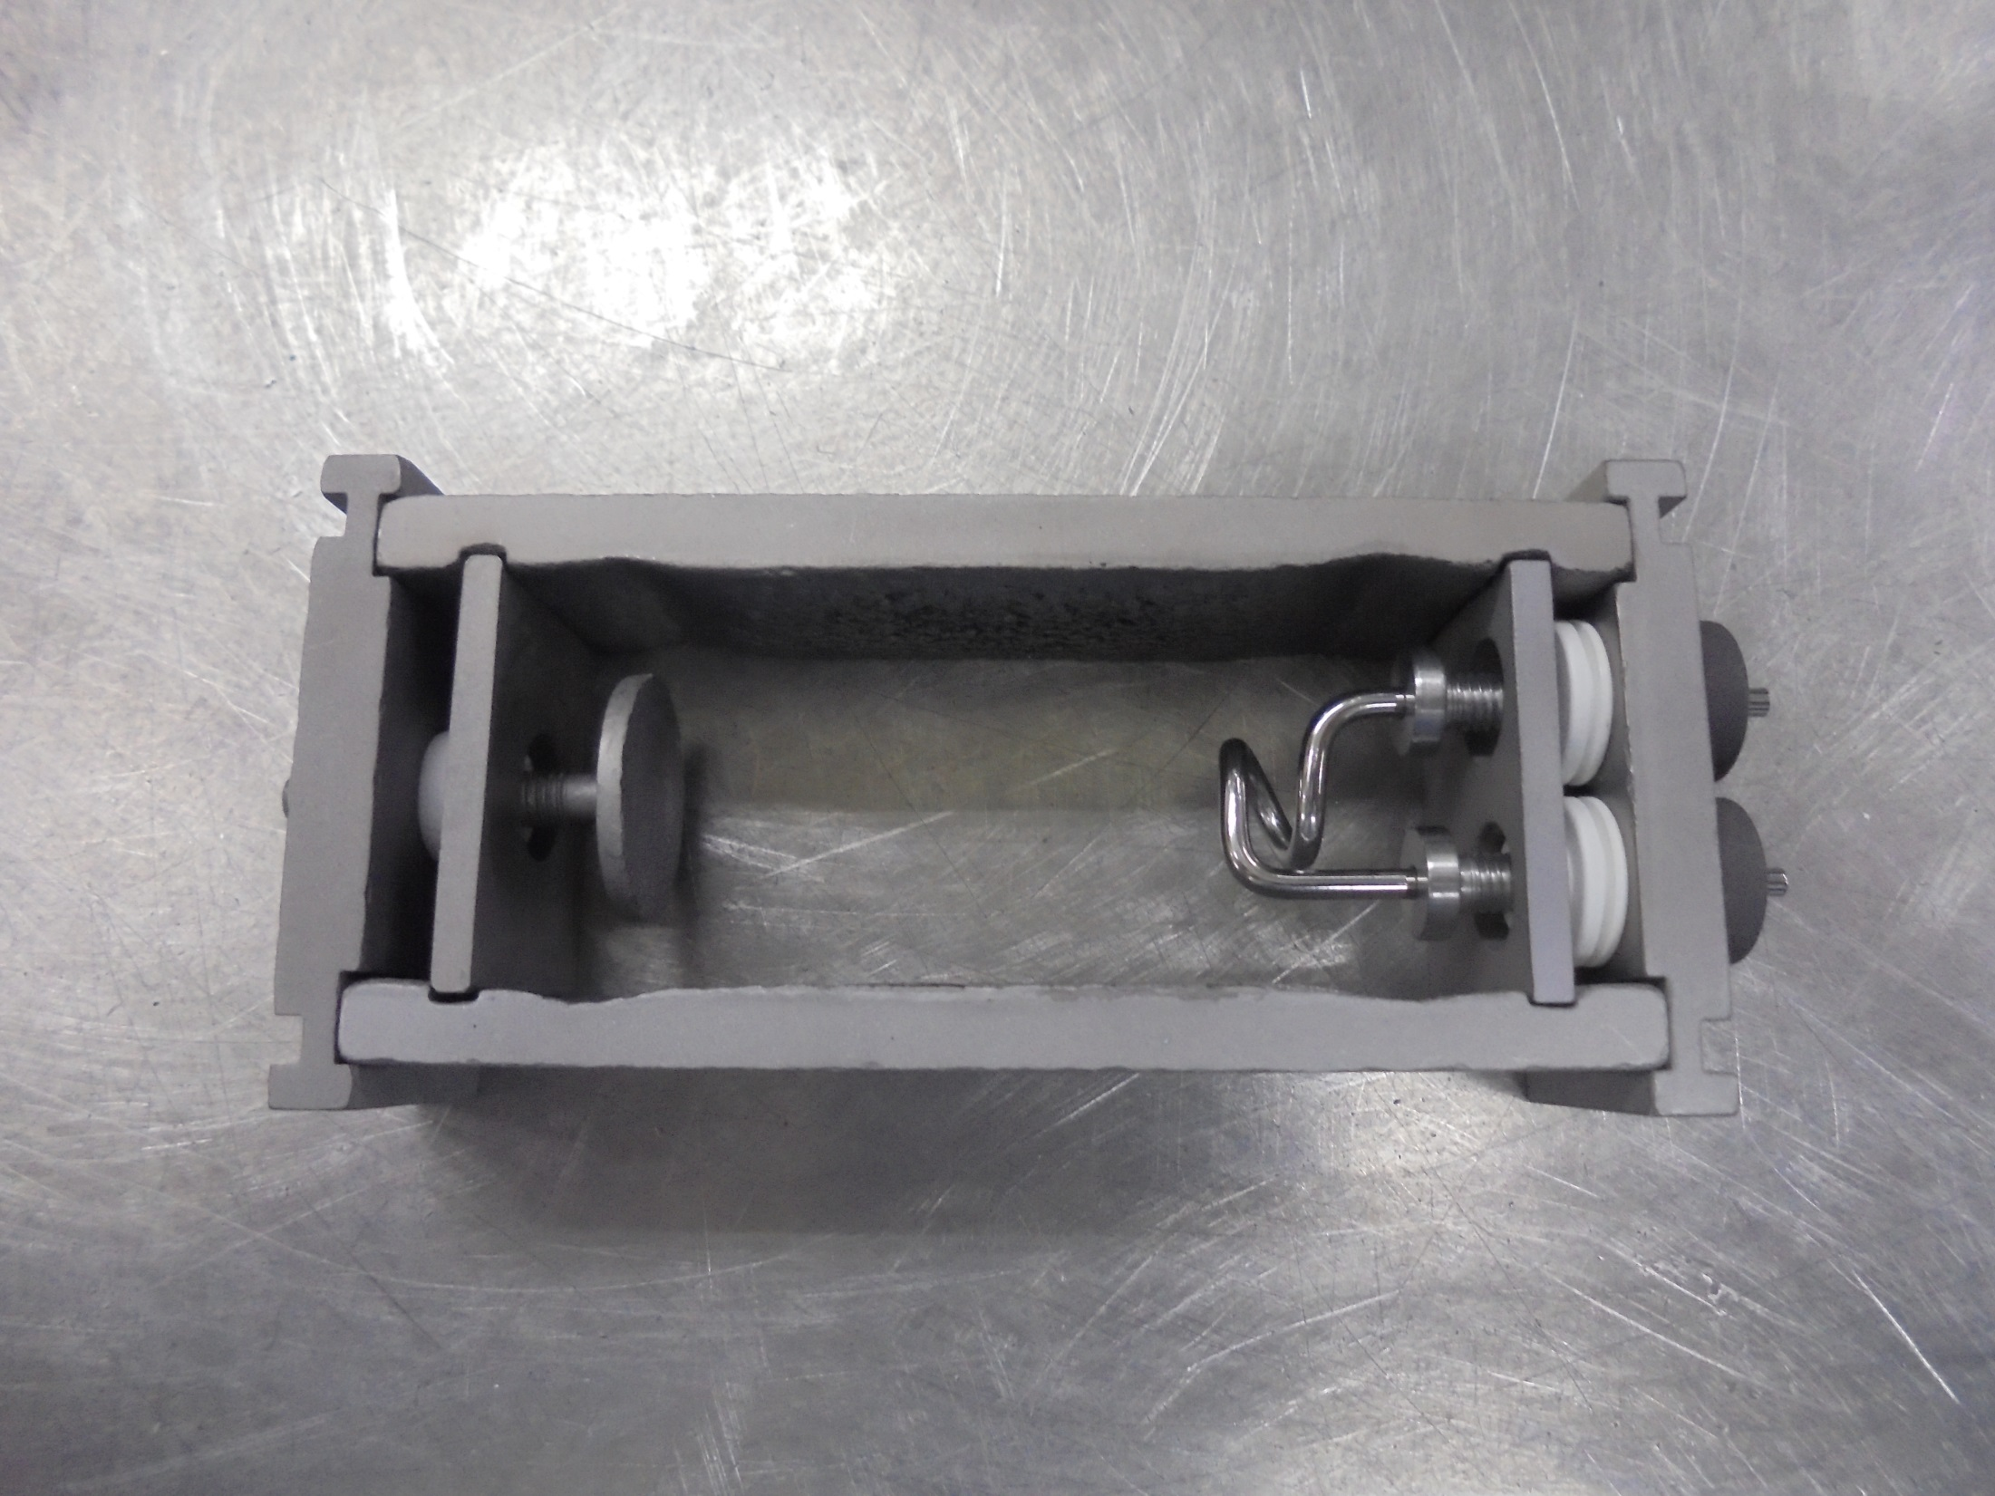
Parts Already Assemble…
(for installing)

Slide 25
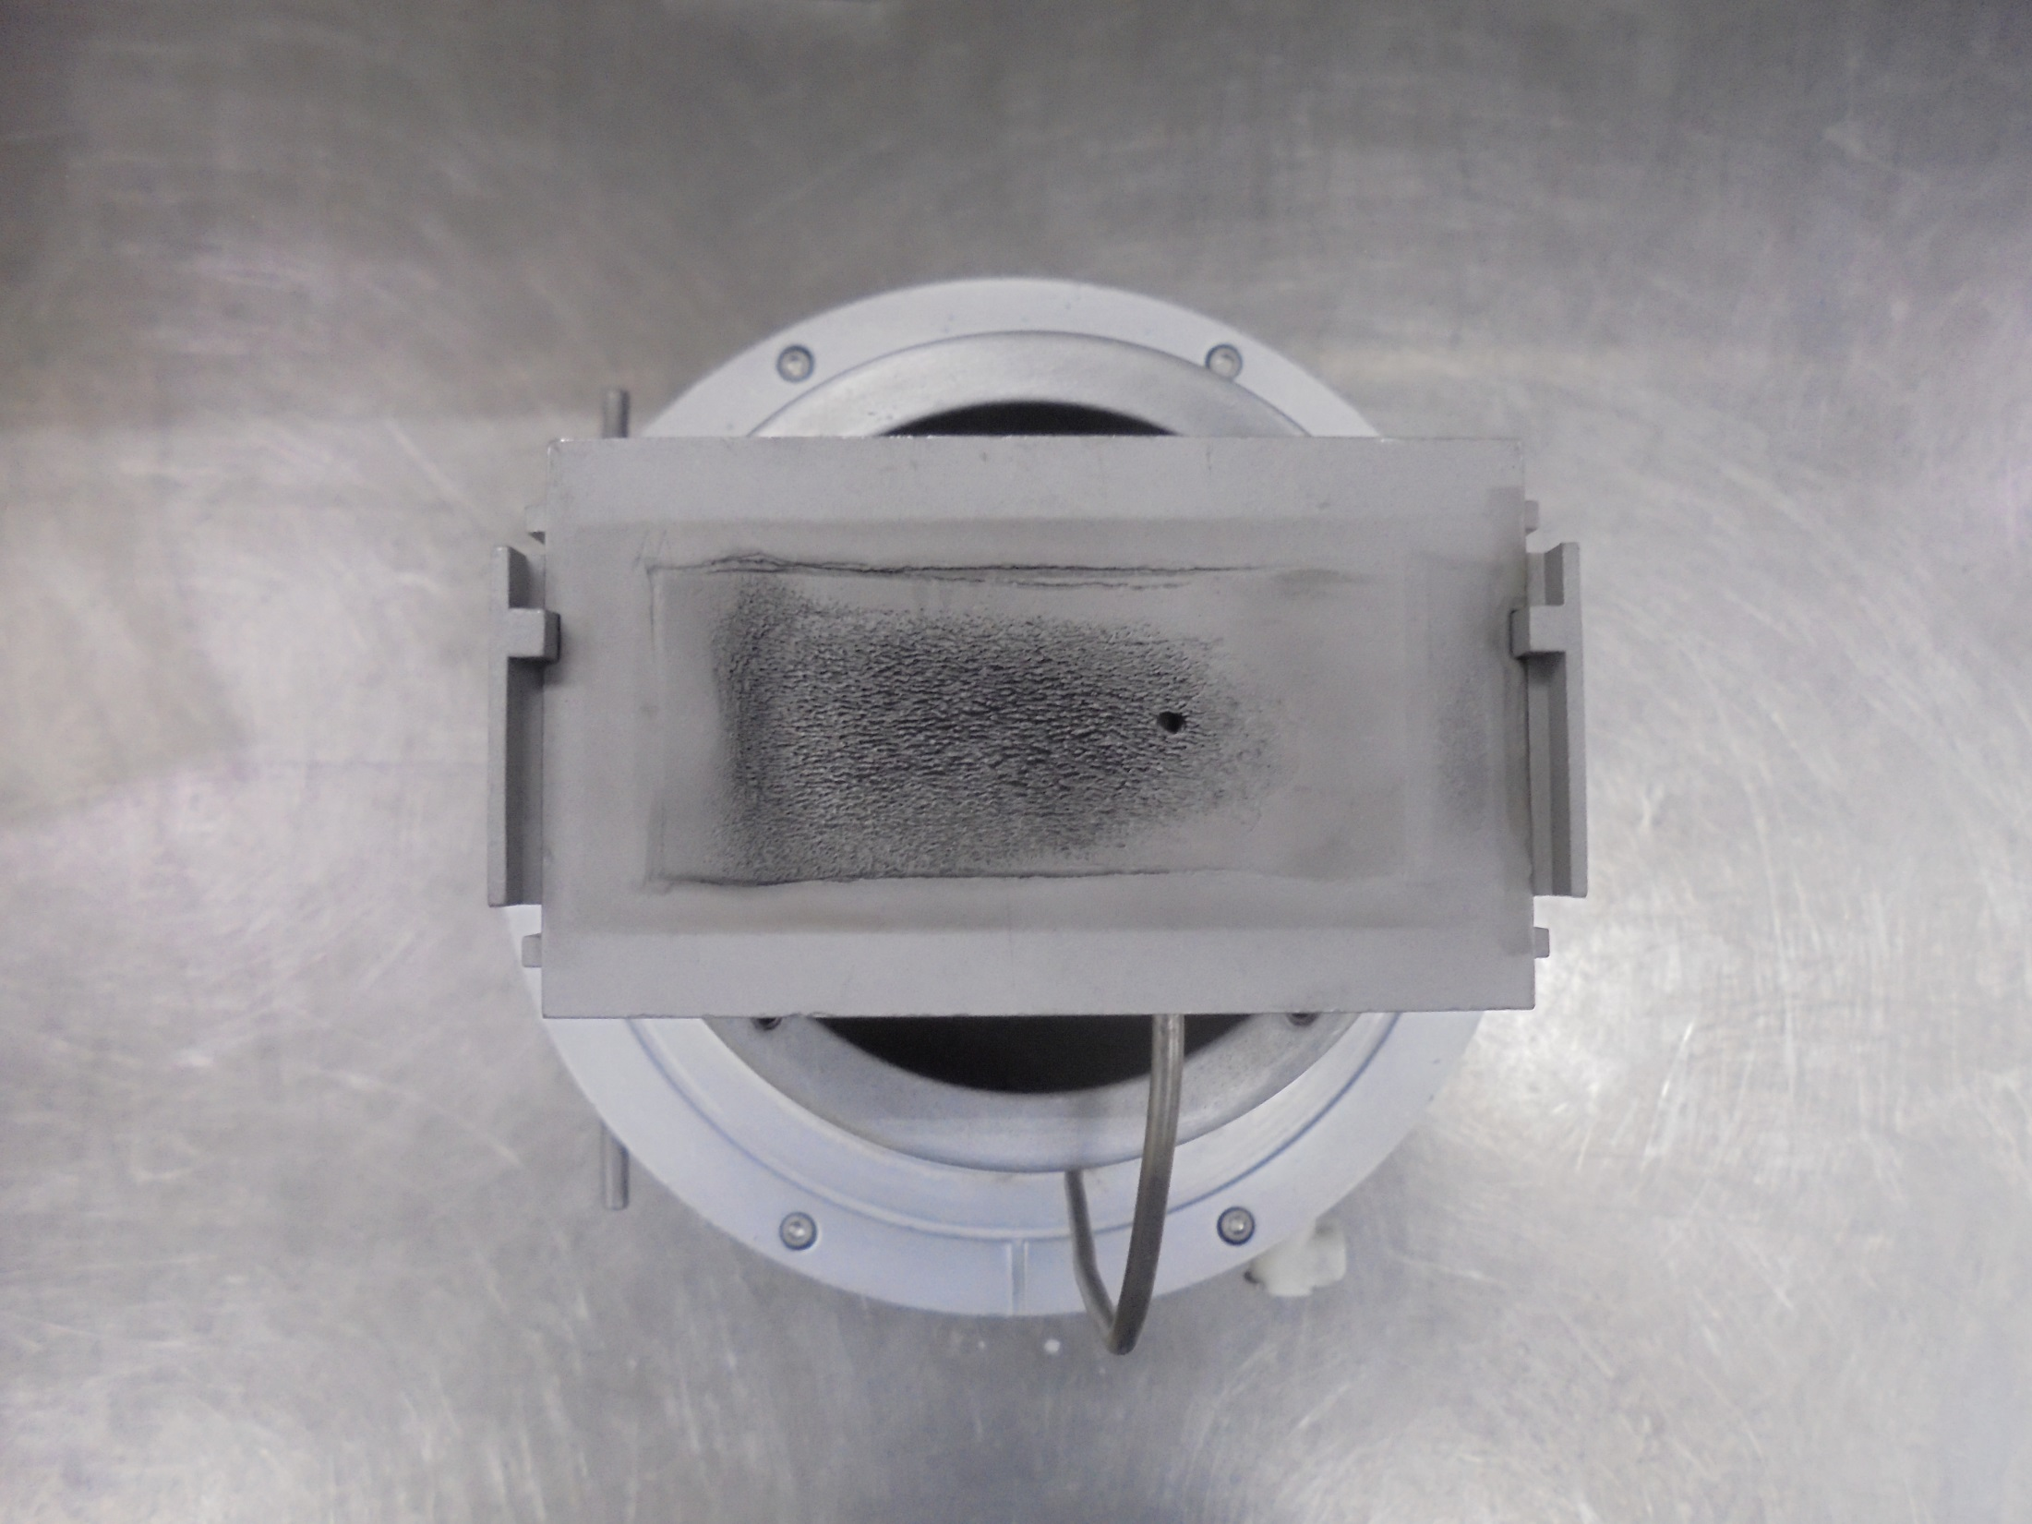
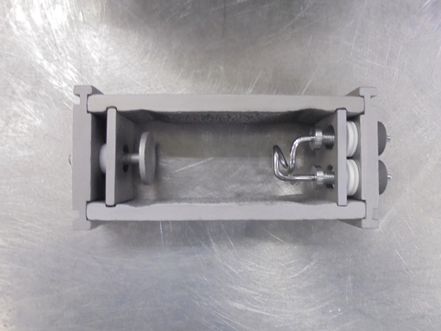
Install This…
Here!

Slide 26
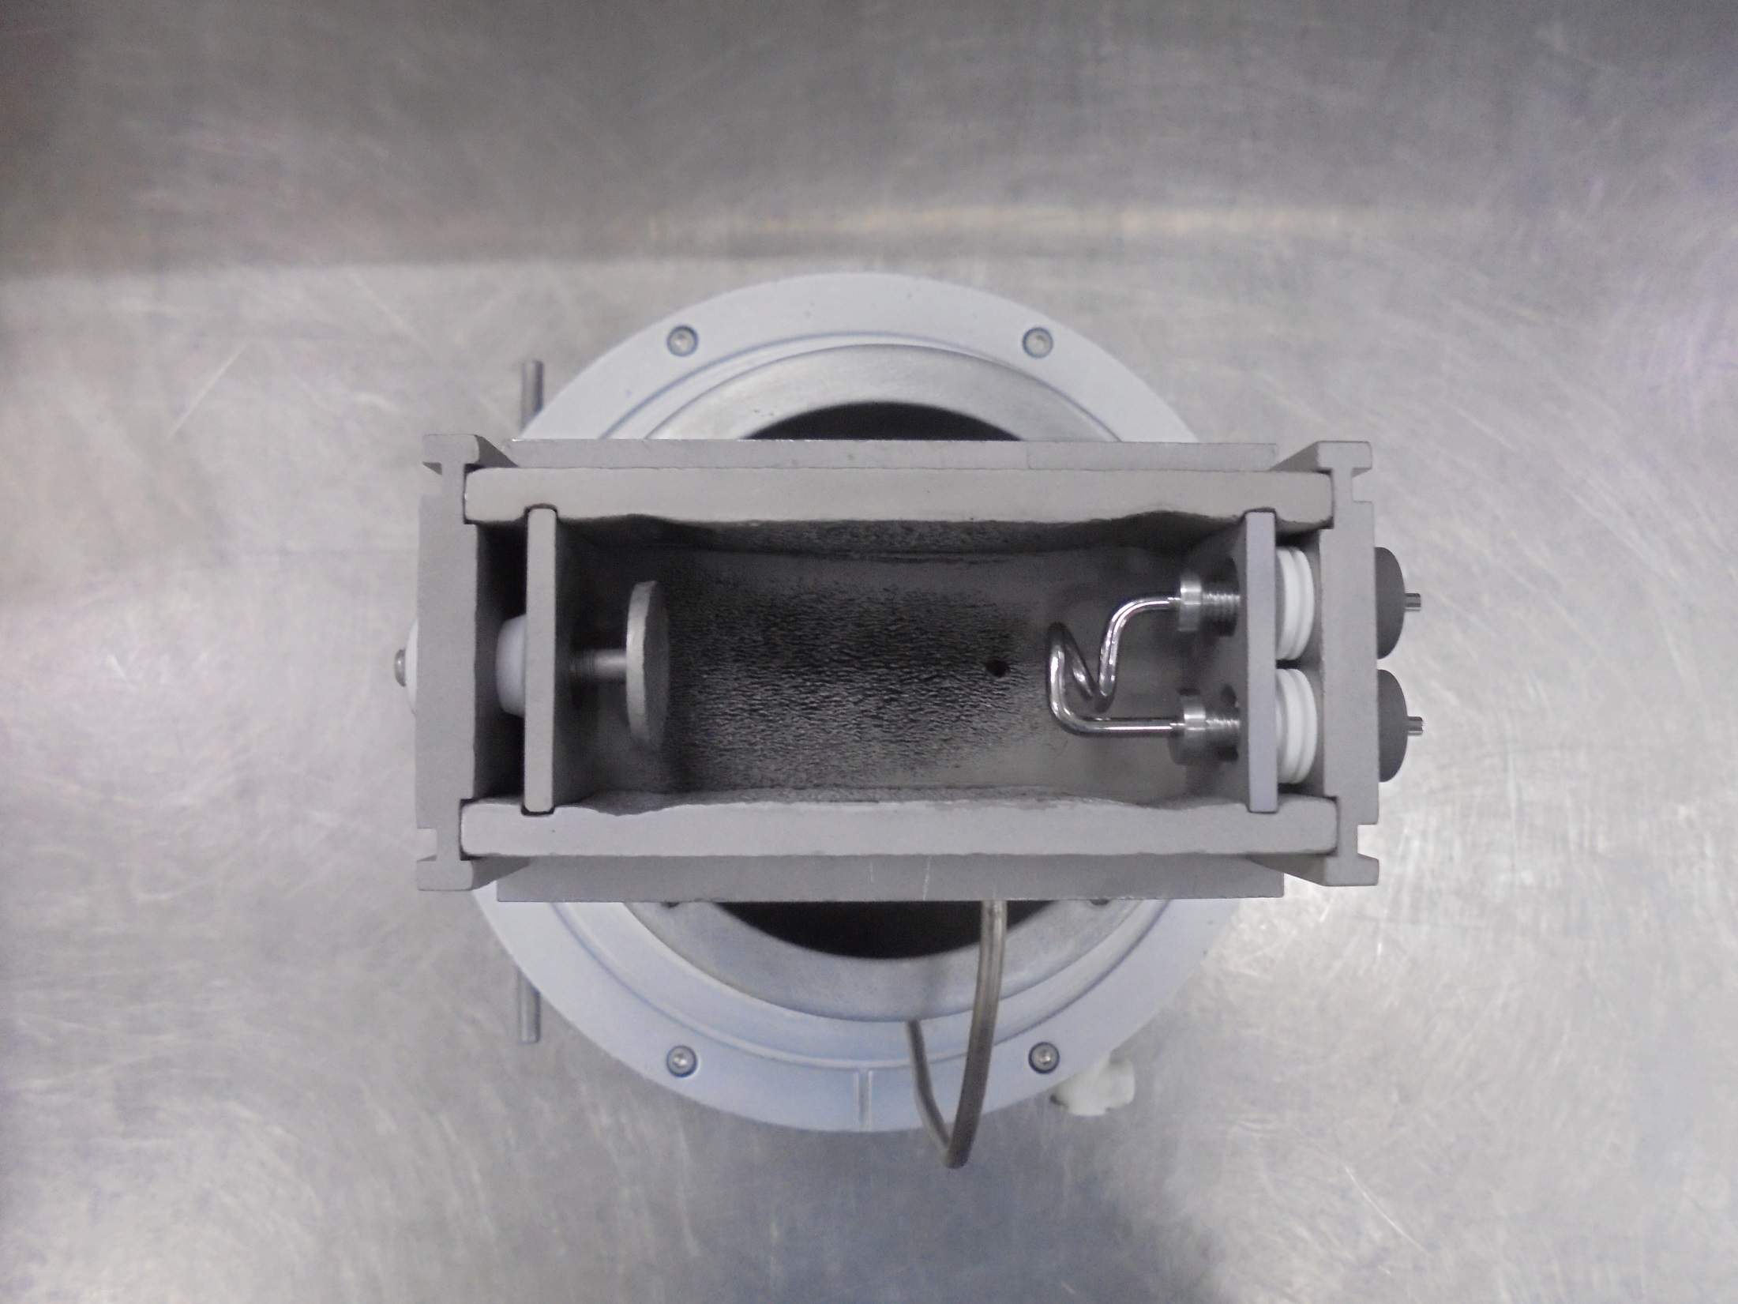
ARC CHAMBER

Slide 27
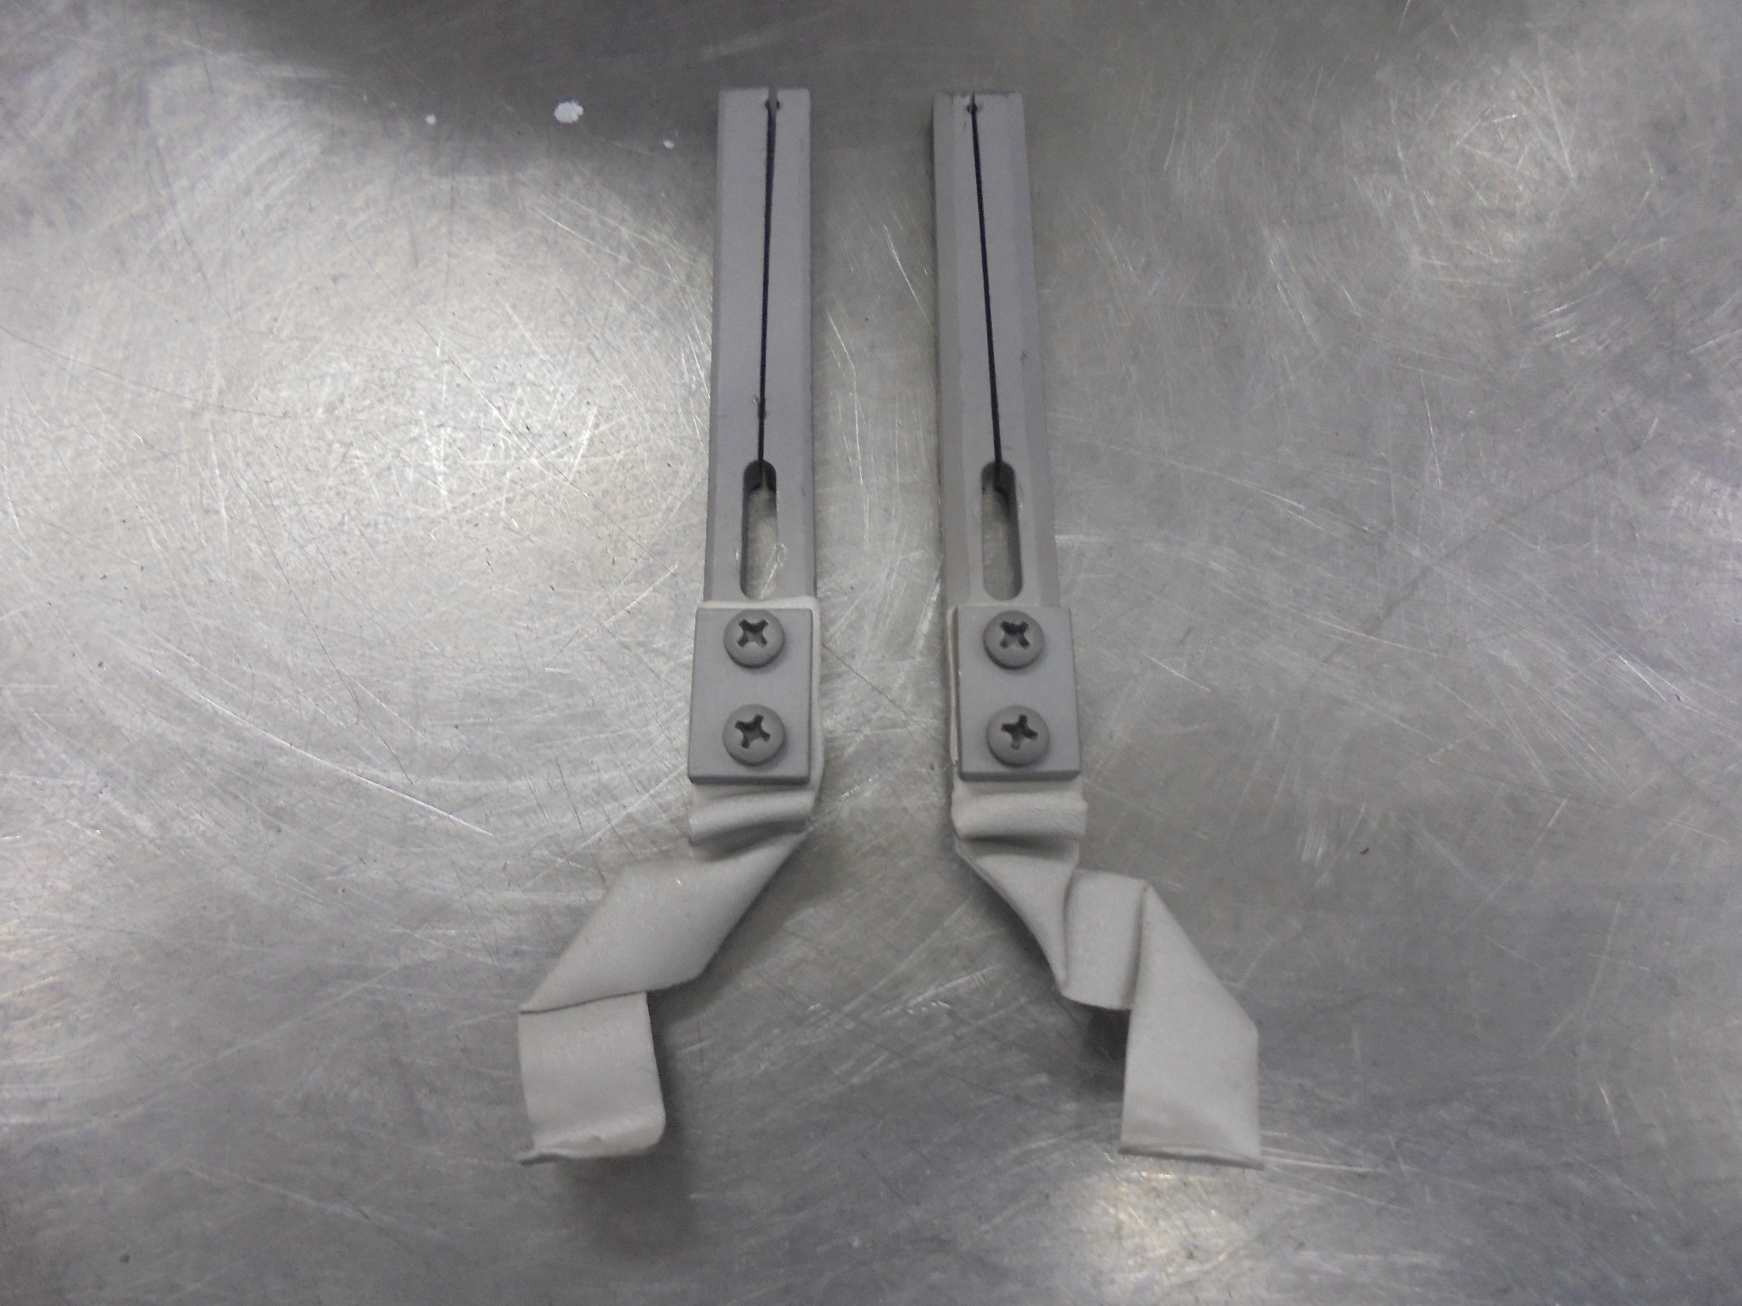
FILAMENT CLAMP
Double check if the screws is tighten
Filament Strap
Attached

Slide 28
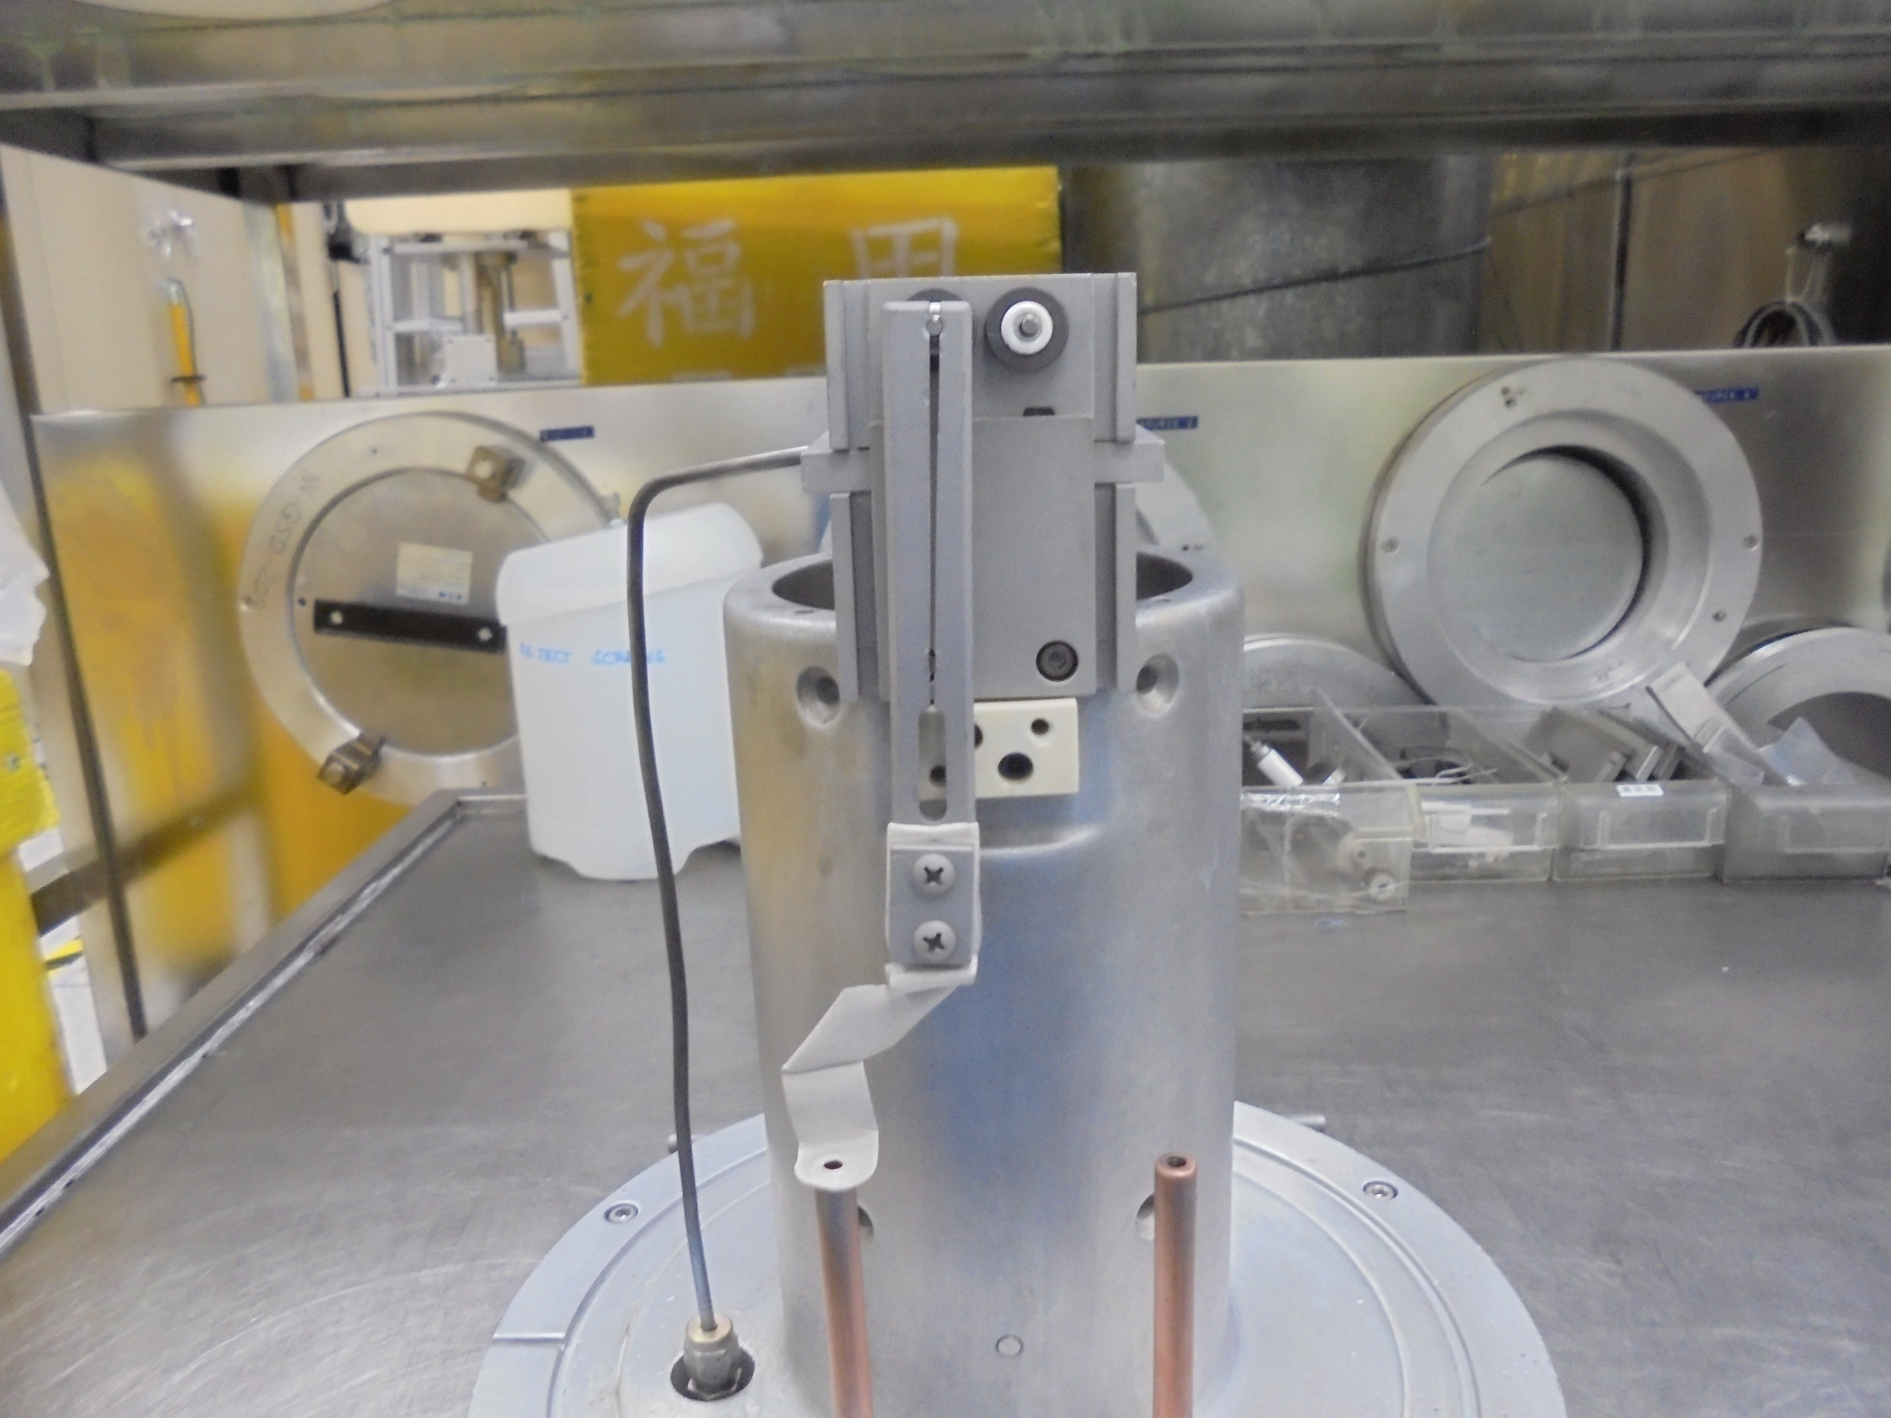
Install Filament Clamp…

Slide 29
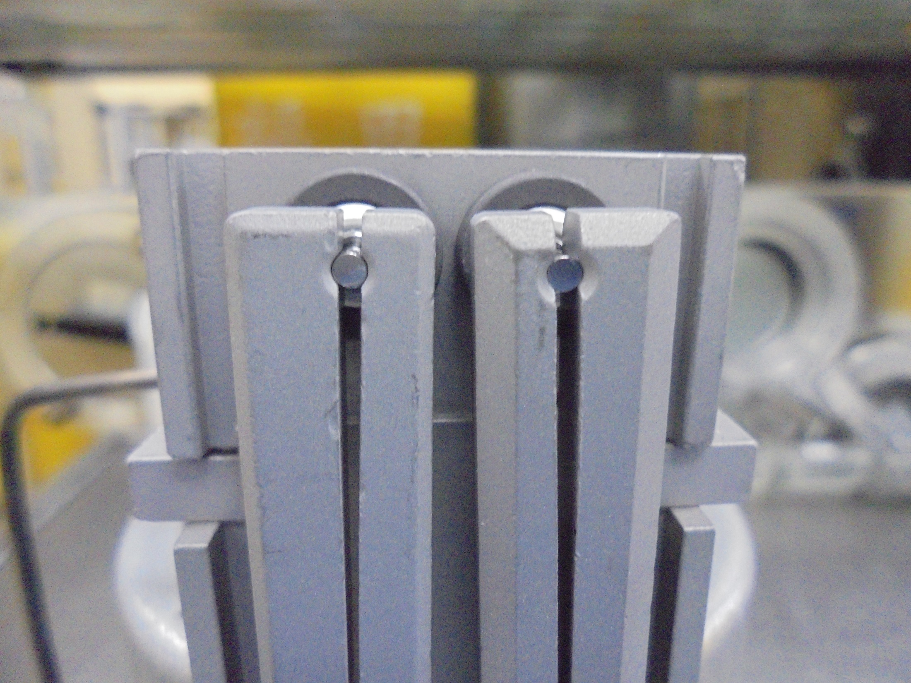
*Notice: Make sure the FILAMENT is not
Protruded on the CLAMP…

Slide 30
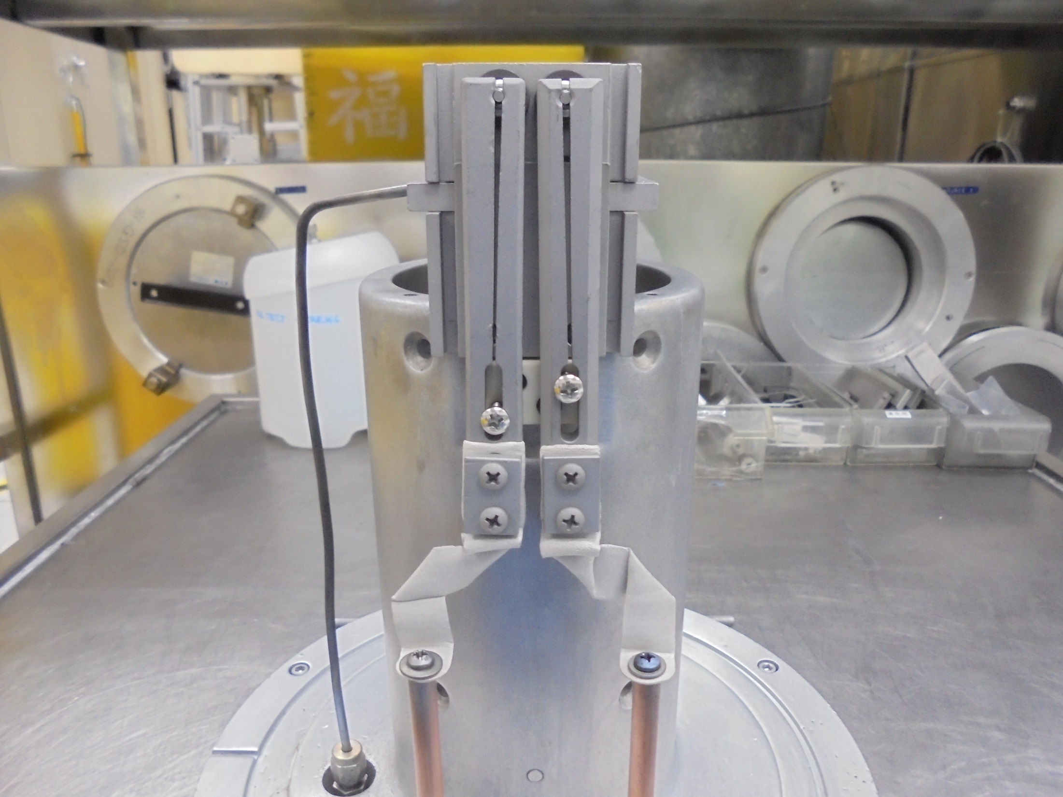
Secure Tighten The Screws…

Slide 31
Isolation Test

Slide 32
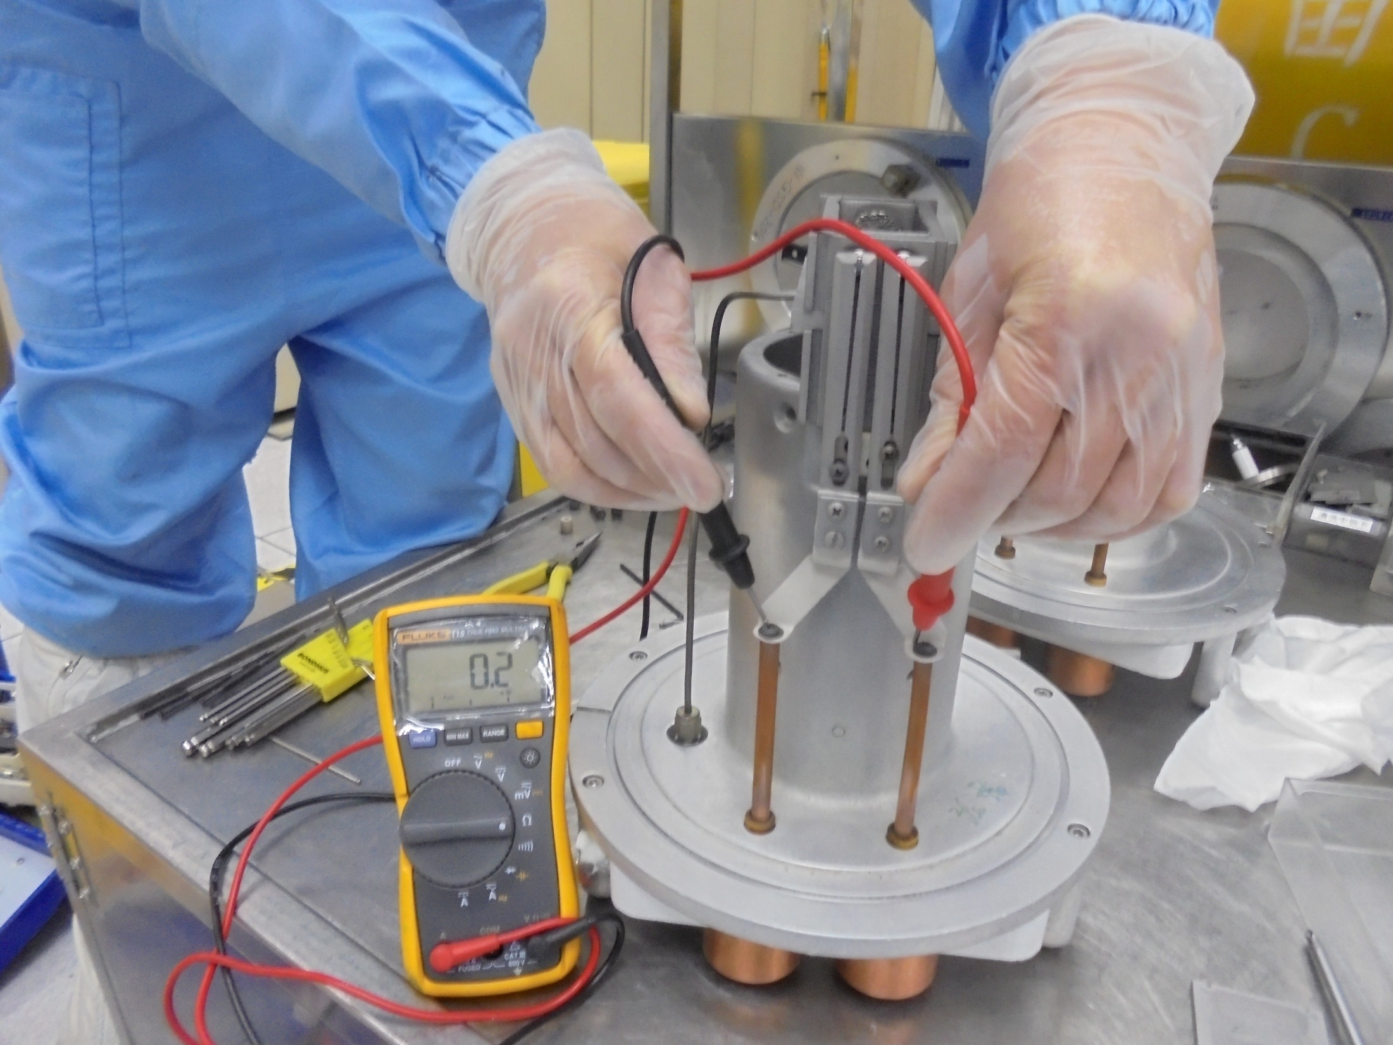
Meter Display – Past!
VTM Setting
Test FILAMENT Line

Slide 33
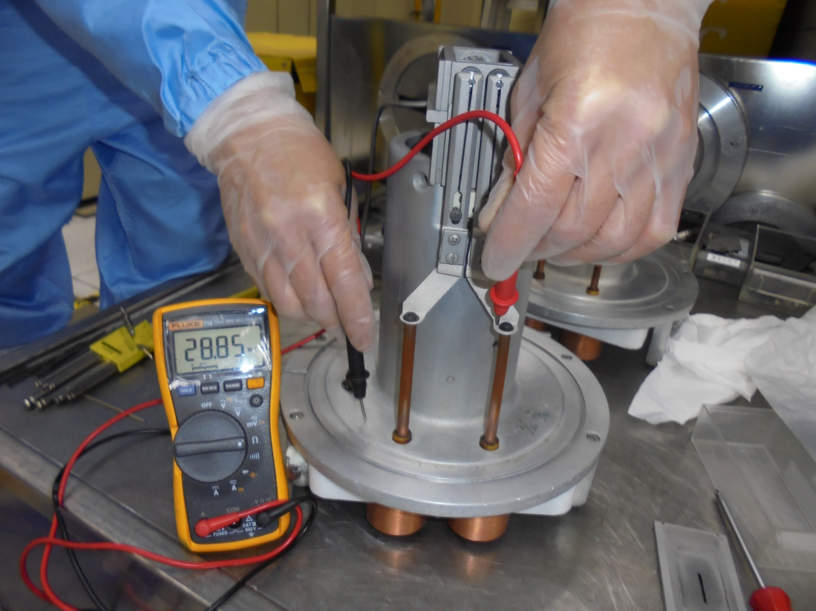
FILAMENT Line to SOURCE Body

Slide 34
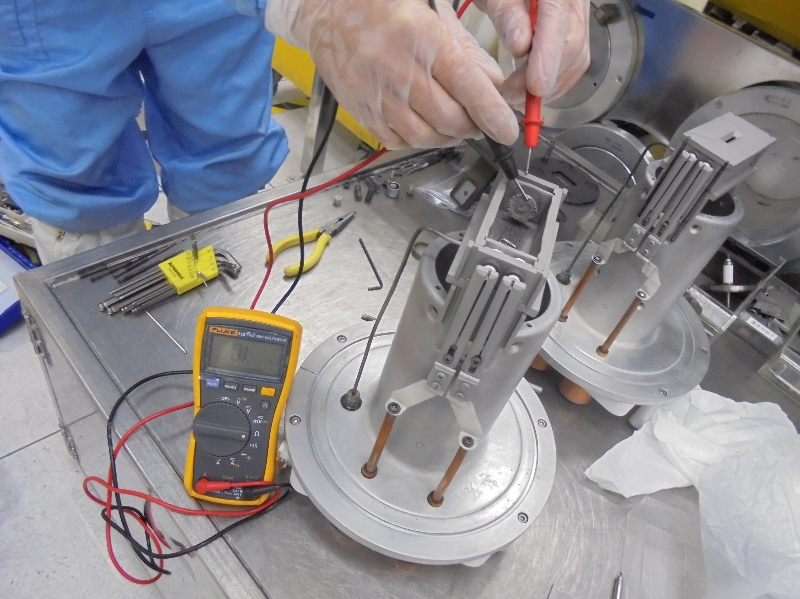
Test REPELLER Isolation
REPELLER to END PLATE
Over Load-Isolated-Past!

Slide 35
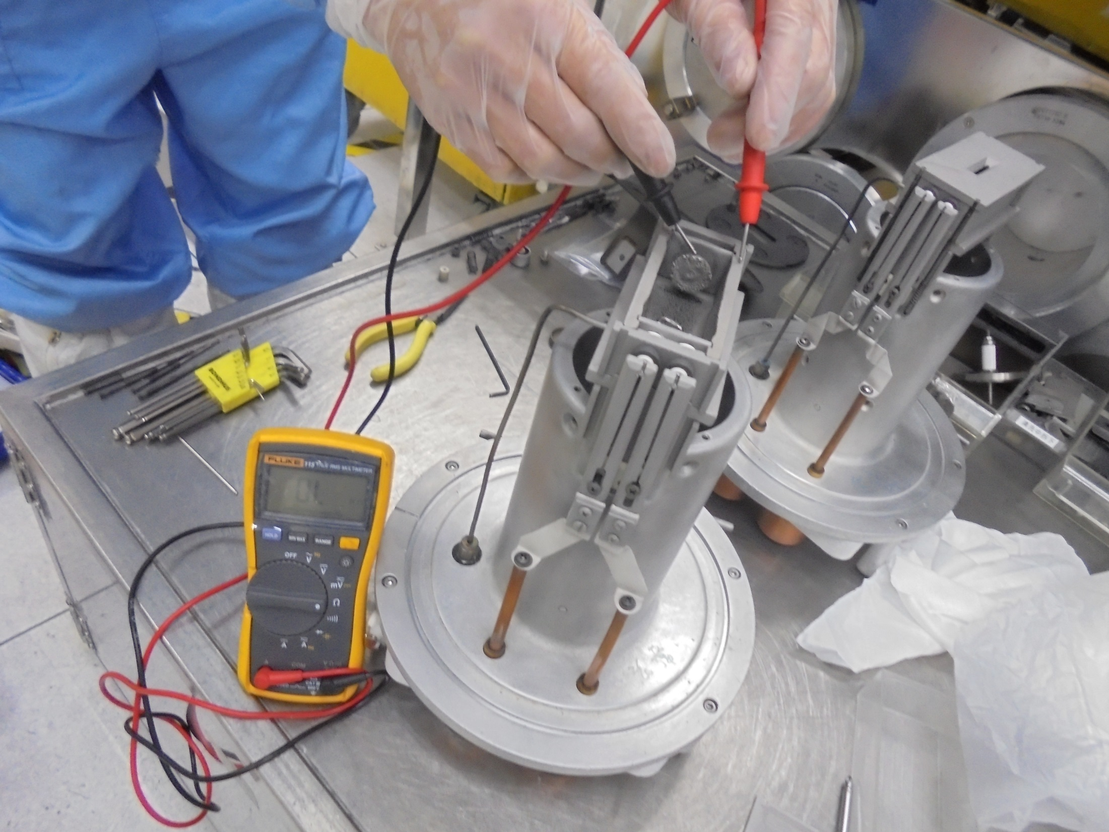
REPELLER to SIDE PLATE
Over Load-Isolated-Past!

Slide 36
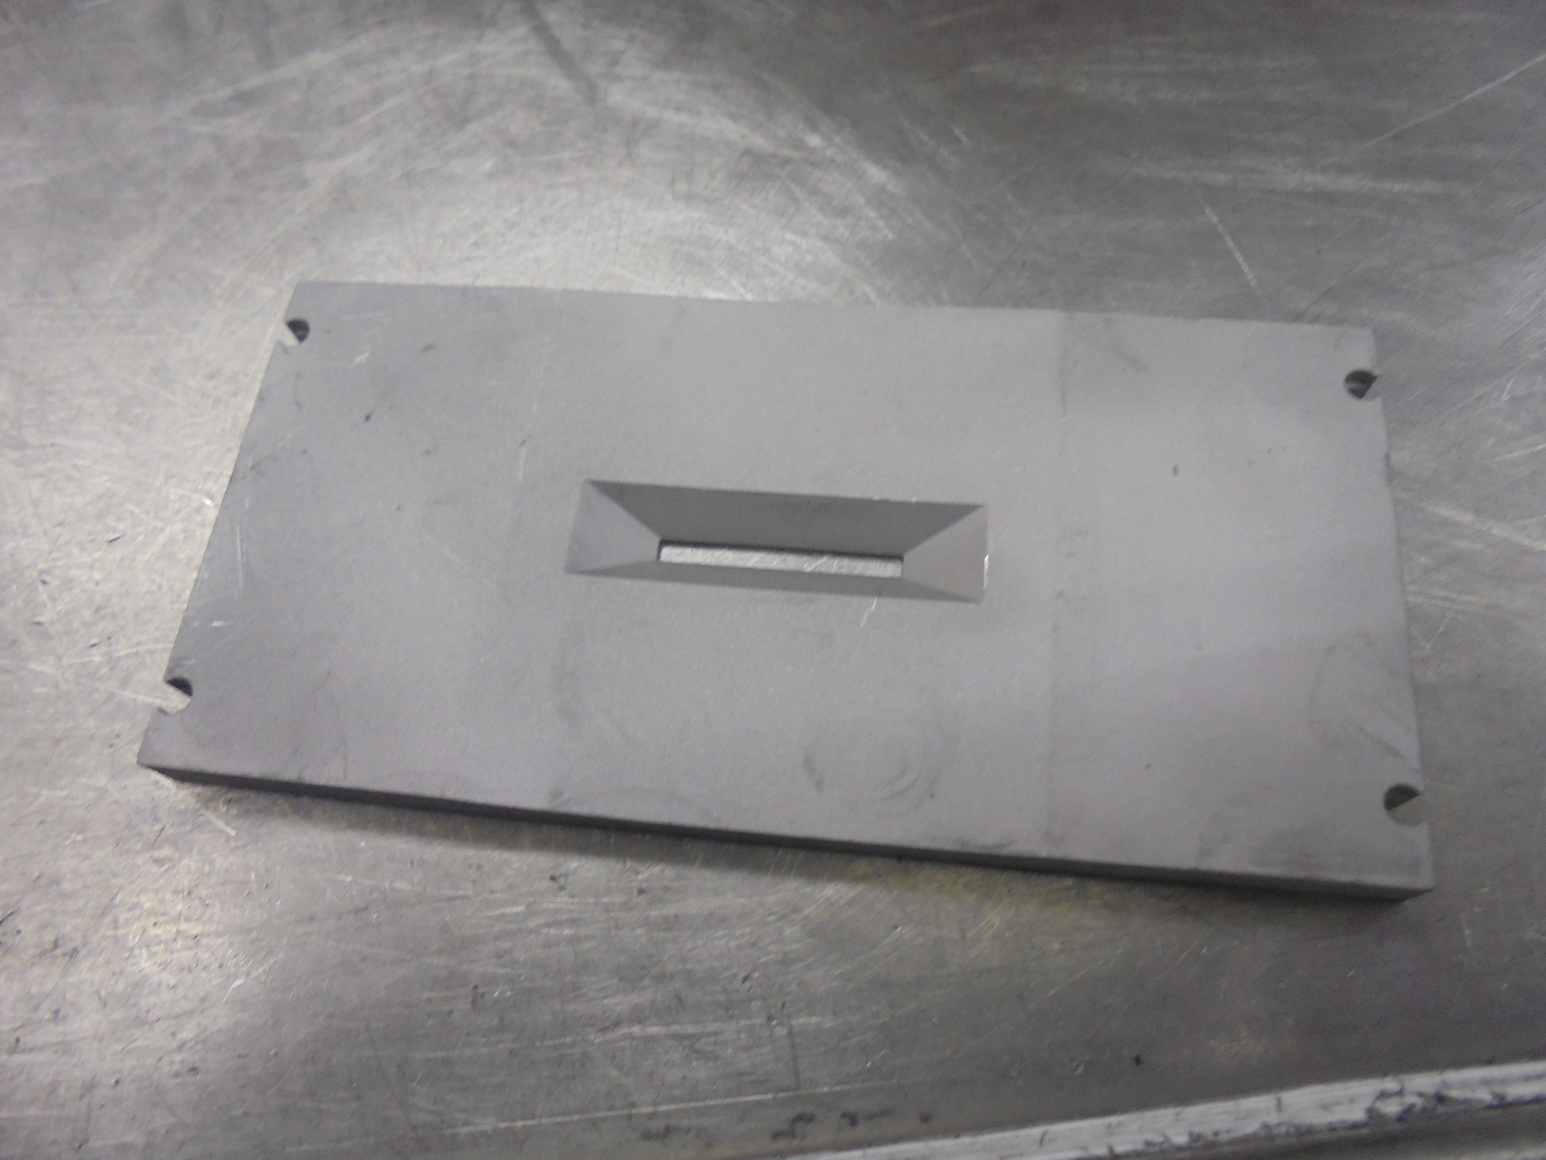
ARC CHAMBER FACE/TOP PLATE

Slide 37
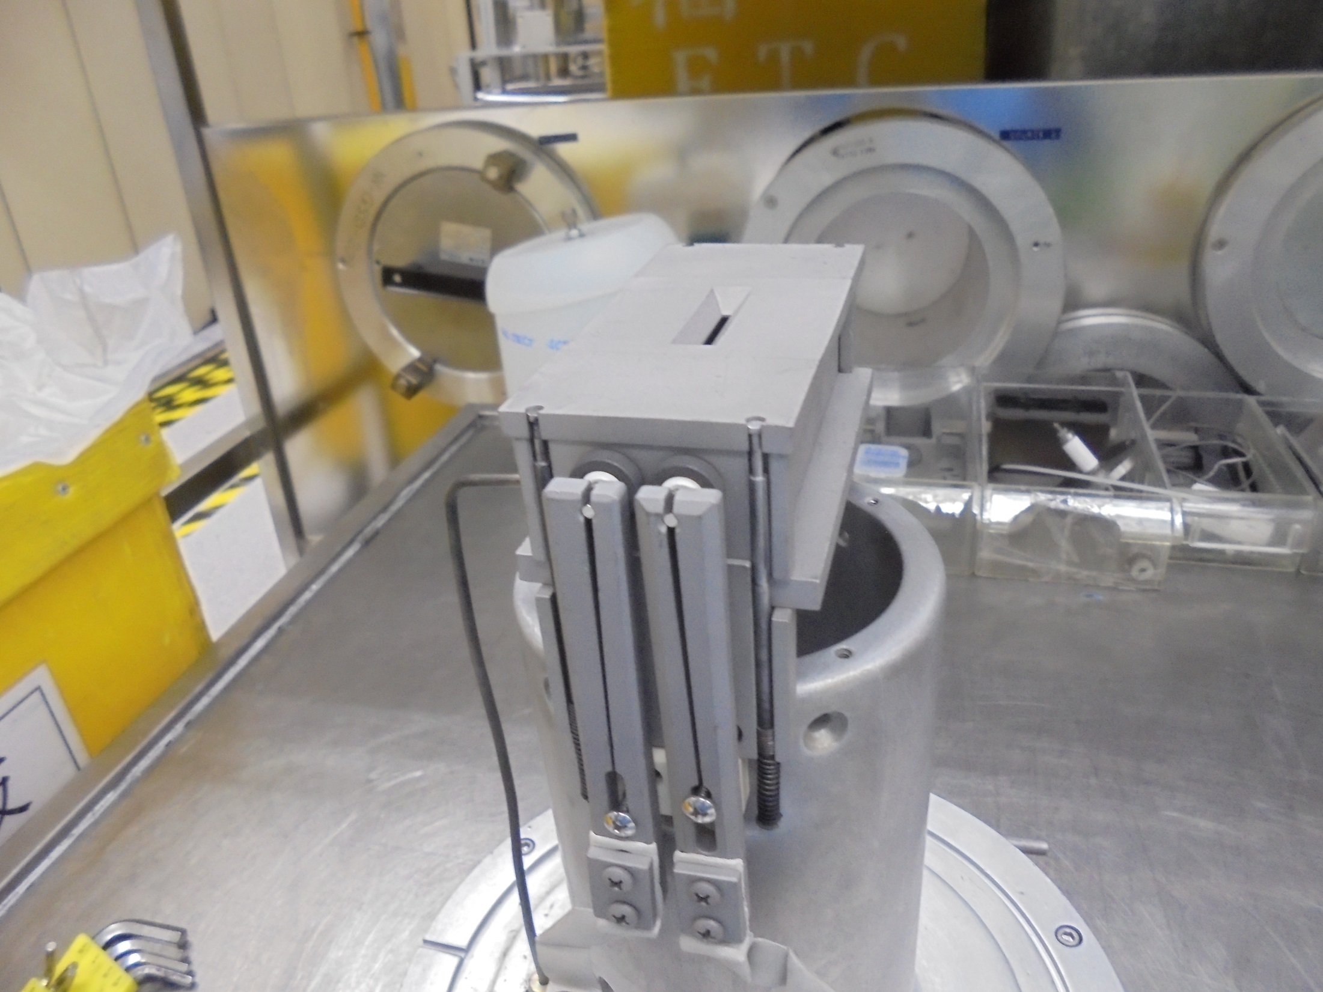
Install on top and secure with
4 RETAINER PIN…
RETAINER PIN

Slide 38
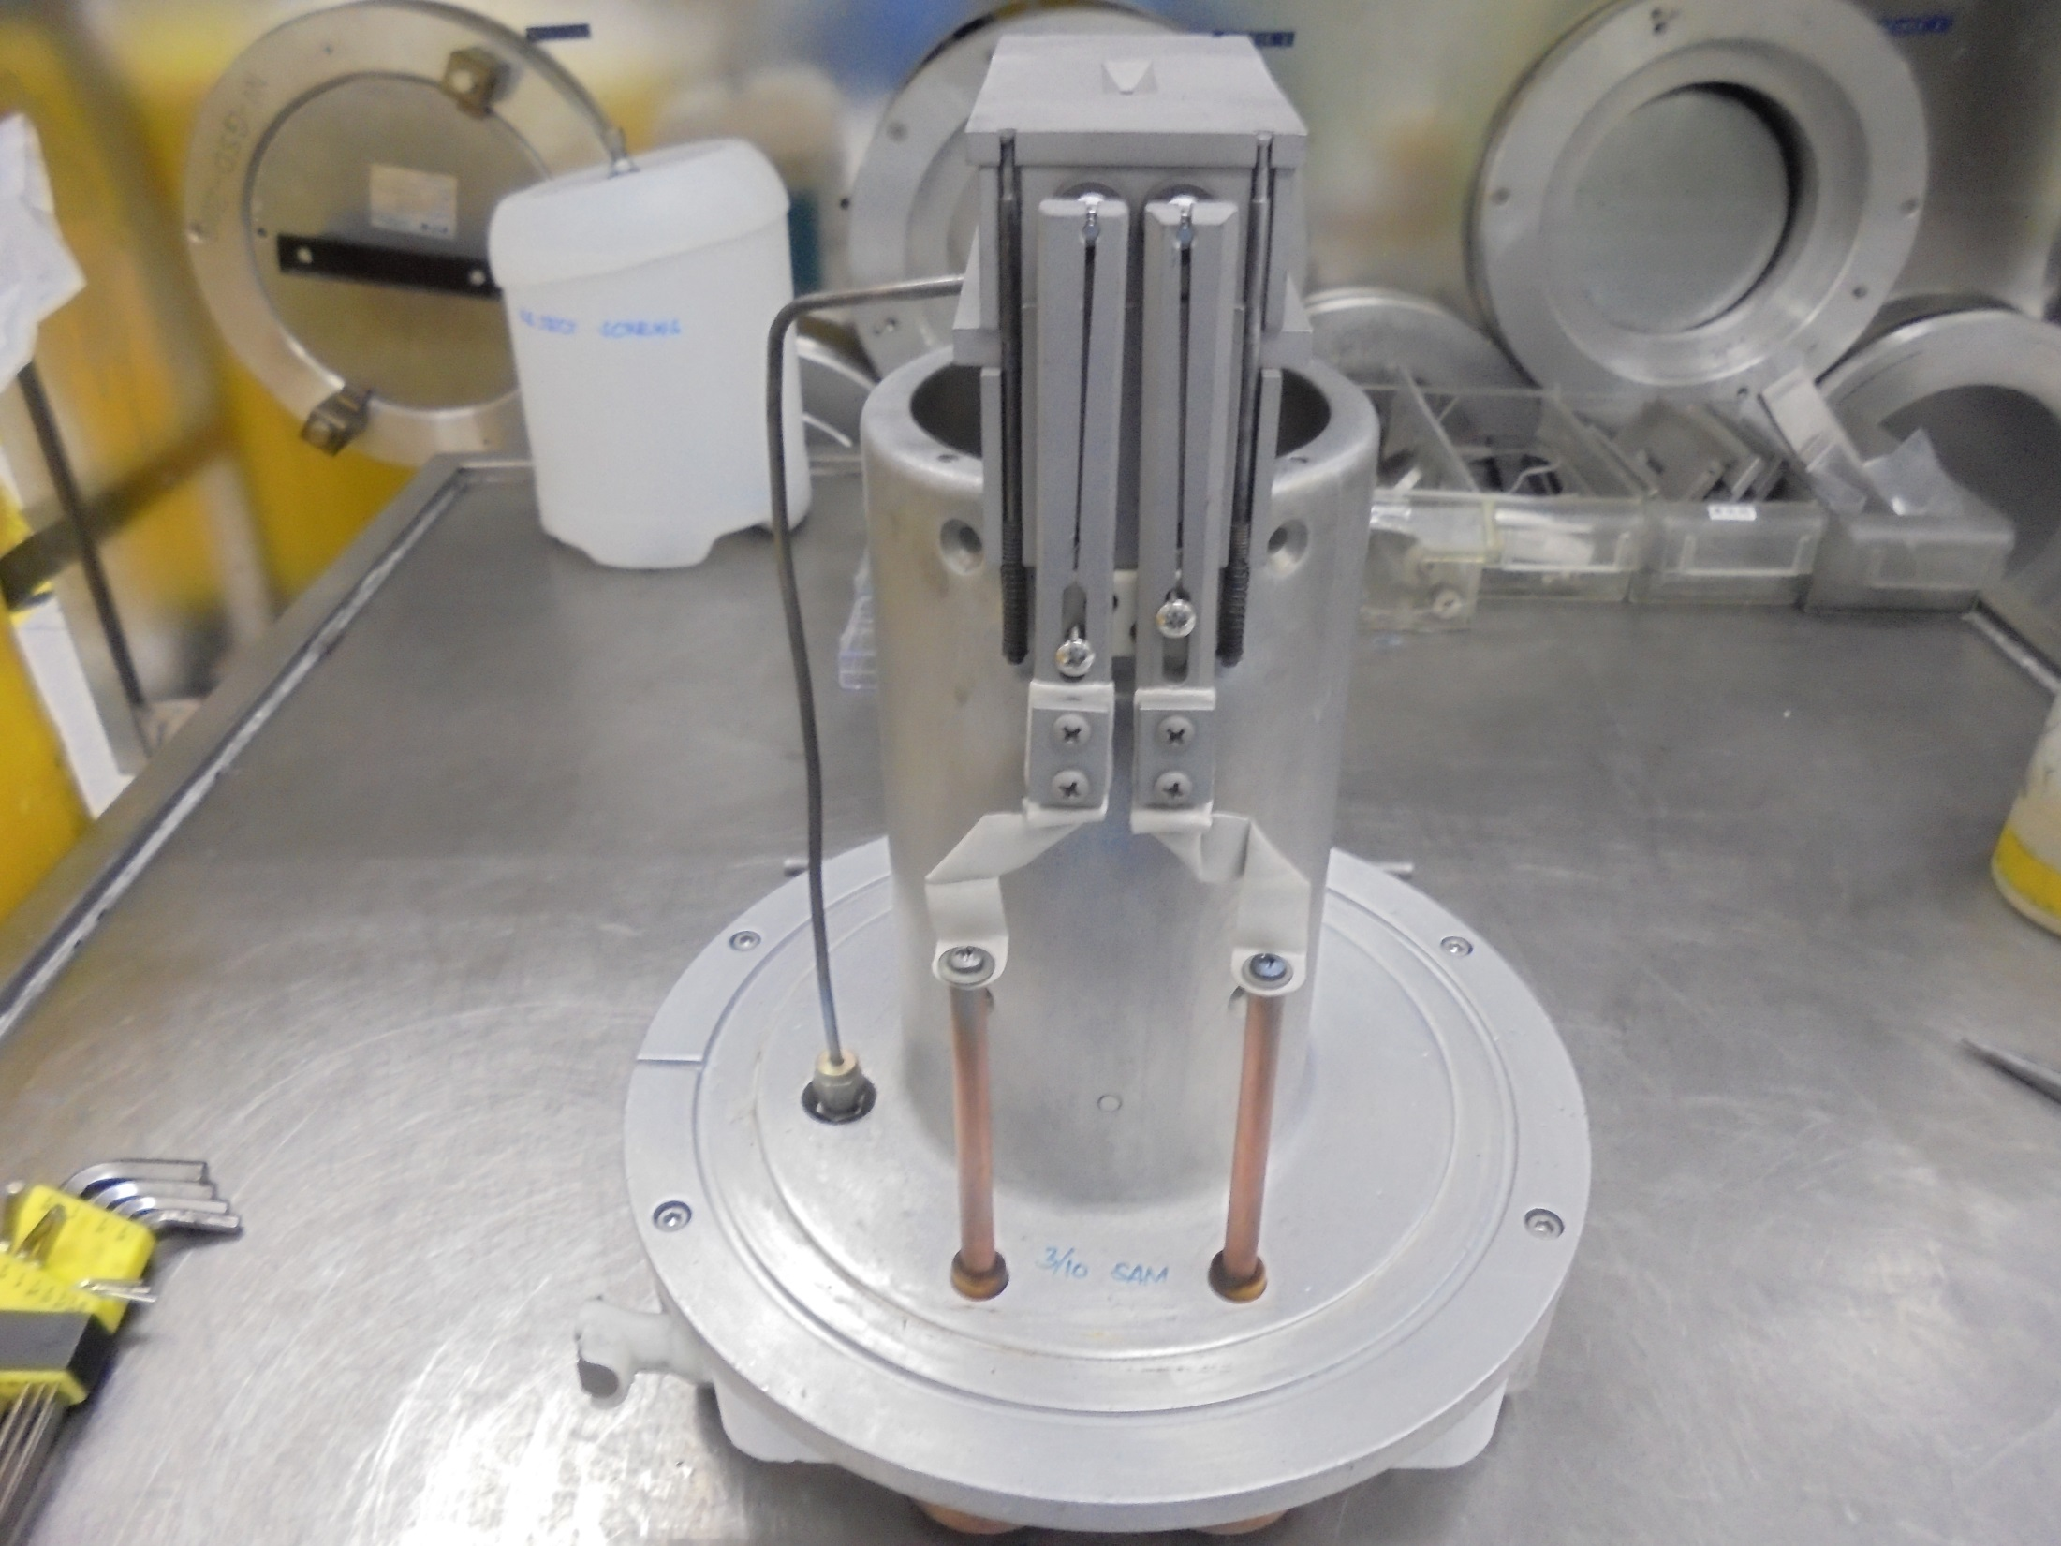
Clean O-RING Slot
with IPA

Slide 39
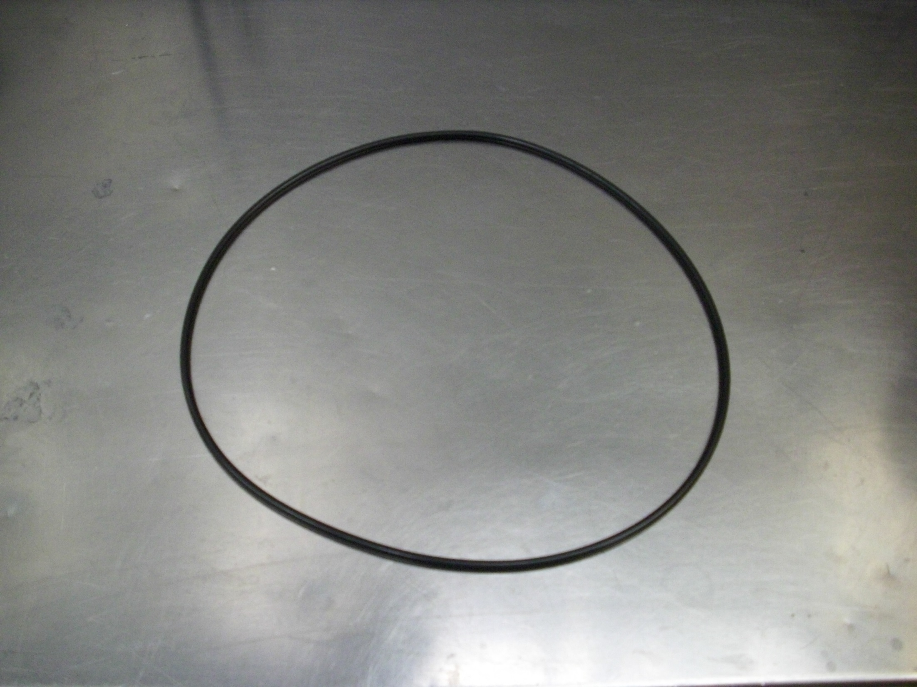
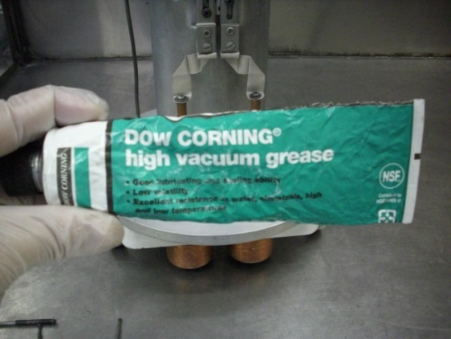
Clean O-RING
Double Check for any Scratch or Damage…
Apply a little amount of High Vacuum Grease
then INSTALL…

Slide 40
Install O-RING

Slide 41
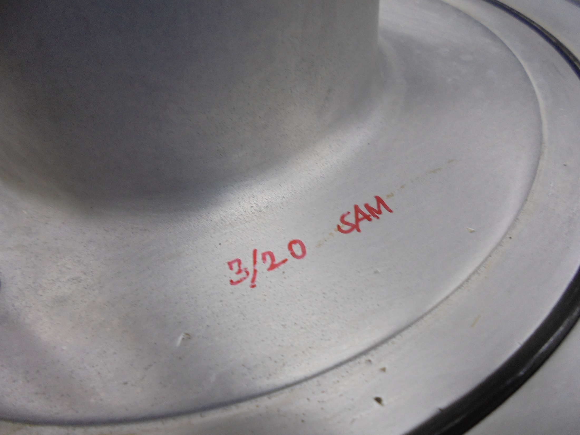
Sign NAME and DATE
Maintenance Done.

Slide 42
-END-

